Slide 1






Embracing AI in Education
with LinkedIn
Nicole Sus
LinkedIn Sr. Account Director
Notes:
Artificial Intelligence is reshaping the world of work profoundly and quickly.
[If your customer is less familiar with AI]
AI is essentially about computers making smart suggestions. Until last year, that showed up mostly in the background through matching algorithms, like search. Then Generative AI arrived, which is a fancy way of saying AI that can not only do stuff in the background, but also in the foreground, like creating content - words, pictures, even essays - from both explicit and inferred prompts.
Whether or not your organization is this technology has already impacted how we work, the jobs we do, and the skills we need to be successful. [an expert at/experimenting with /hasn’t yet started to explore AI],
Business leaders across the board – including Talent leaders – have been asked to transform their teams and strategies. HR orgs will need to maximize productivity and skill proficiency to stay ahead in the age of AI.
LinkedIn can help you become AI-ready, today.

Slide 2
Accelerating productivity and efficiencies through automation.
of LinkedIn members are in occupations that could leverage GAI to automate at least a quarter of routine tasks and increase productivity.
Artificial Intelligence
is driving two foundational shifts
Source: Redefining Work
Reshaping the skills every organization needs.
21X
The share of job postings on LinkedIn mentioning GPT or Chat GPT skills increased by 21x since November 2022.
Source: Future of Work Report November 2023
Notes:
HR orgs will need to evolve to stay ahead of the changes AI is driving in the world of work. There are two foundational shifts impacting this new era.
AI is driving productivity and efficiency through automation
Across industries and companies, executives believe GAI will benefit employees by 'removing boring, repetitive tasks' and 'increasing productivity'. Not only does this save time, but it also guarantees that those repetitive tasks will now get completed by AI consistently and on-schedule. For better or worse, AI is resetting expectations on how efficiently teams are able to run.
We find that 84% of LinkedIn members are in occupations that could leverage GAI to automate at least a quarter of routine tasks and increase productivity.
AI is reshaping the skills your organization needs, creating greater distance between the ‘haves’ and ‘have nots’
About thirty years ago we entered the era of digital transformation, which radically changed the skills your organization needed and the way you operated. We’re entering a similarly transformative era with AI, where not only will completely new functions emerge, but perhaps even more meaningfully, where every function will need to adapt and leverage AI skills to do their day-to-day responsibilities.
The share of job postings on LinkedIn mentioning GPT or Chat GPT skills increased by 21x since Nov. 2022

Slide 3
Your AI moment is now.
of US executives agree that they are planning to increase their use of AI at their organization in the next year.
Source: Future of Work Report November 2023
Notes:
Are you ready to stay ahead in a shifting world of work? Do you know what an HR ready organization looks like? What is your plan for getting there?
While the future is hard to predict, we do know that these shifts are already happening, and it's important to begin your journey to being AI-ready now, or risk being left behind.
Leading your organization into the future will unlock unimaginable opportunities to drive business impact at scale.

Slide 4
LinkedIn Learning Solutions
AI Content Framework
Training
Appropriate for AI/ML Engineers and Data Scientists only. Includes training neural networks, fine tuning, and model optimization.
5
Content to serve every level and layer of your organization´s AI journey
AI/ML Specialist
AI/ML Specialists
MLOps.
Cloud. Security.
-
Building
Hands-on content for working with LLMs from low-code methodologies to in-depth content for developers.
Maintaining
Appropriate for roles implementing AI.
Includes MLOps, Cloud, Security, Certification Prep, and Orchestration and Frameworks.
4
Power Users
Tech Audiences
3
LLMs. GPTs. APIs. Vector Databases.
-
Functional Roles
Leaders and Managers
Prompt Engineering. Copilot. General AI productivity.
-
Applying
Prompting. Productivity. Strategy.
Appropriate for all professionals. Includes prompt engineering and copilots.
2
Understanding
Fluency. Awareness.
Appropriate for all professionals. Includes GenAI fluency and Responsible AI.
1
AI literacy. Generative AI. Responsible AI.
-
All Professionals

Slide 5
Leading
AI-Readiness for industry
AI is a core part of business operations and strategy
Accelerating
In the next few years, the talent orgs that invest in AI to unlock productivity and employee skill proficiency will stay ahead.
Talent architectures and workforce planning : Business uses skill insights to influence strategic planning
AI adoption is standardized across org
Determine how ready you are for AI today, based on the AI Maturity Model.
Align across your org on where you want to be in
6 months, 1 year, and 3 years.
Take one step forward with at least one concrete action towards building to a more AI-enabled future.
Emerging
Early experimentation with AI
TA productivity: Manual and repetitive tasks are automated, freeing up time for more
human-centric tasks.
Personalized learning: Organization has always-on access to personalized skill development in the flow of work
of customers that are integrating or experimenting with Gen AI tools, nearly half find it allows them spend time on more fulfilling tasks due to automation.
Source: 2024 FOR Report
The AI Maturity Model
Notes:
The HR orgs that operate faster and more effectively with AI will stay ahead.
So how does this come to life? HR AI readiness boils down to three dimensions.
TA productivity: saving time, reducing mundane tasks to create space for more strategic, human-centric work, and creating consistency by automating workflows and routine tasks will become the hallmark of high-performing HR orgs.
Personalized Learning: AI will finally unlock the promise of personalized learning that’s in the flow of work. Harnessing the right learning technology and cultivating a culture that prioritizes and rewards learning will be paramount given AI will impact all functions, not just tech functions.
Talent architectures and workforce planning: developing an insights-driven view into the skills you need across your org. Context is key here as your skills strategy must be relative to your competitive set, business strategy, and geographic constraints. The era of ‘one size fits all’ skills strategy is behind us.
Where are you on this map?
Regardless of where you are today, your goal should be to try something out, and take one concrete step towards building a more AI-enabled future. The stats support it. Of the 27% of customers that are integrating or experimenting with Gen AI tools, nearly half find it allows them to spend time on more fulfilling tasks due to automation.

Slide 6



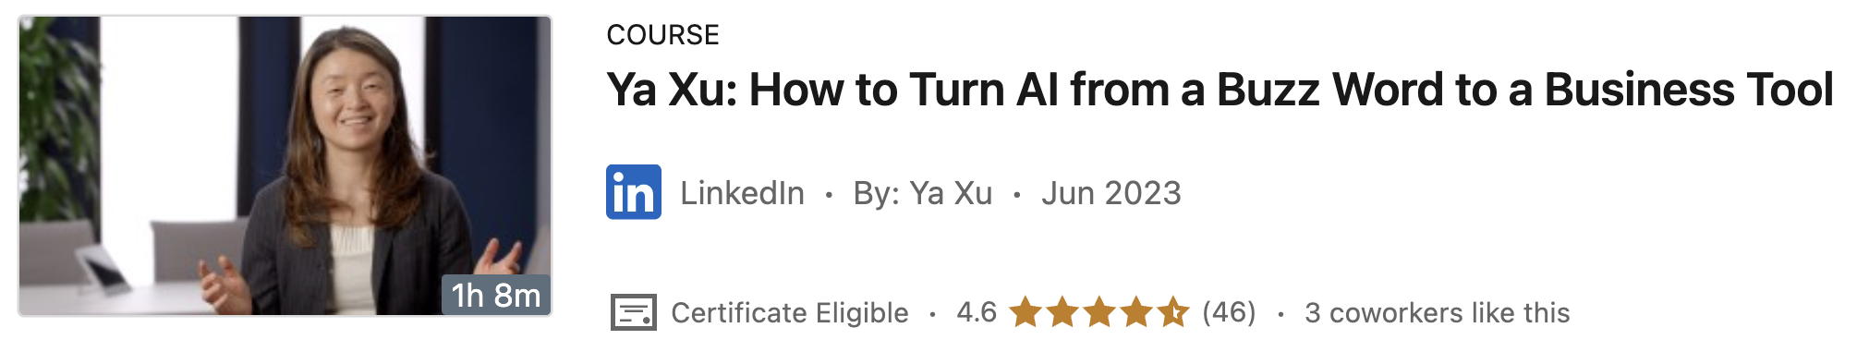
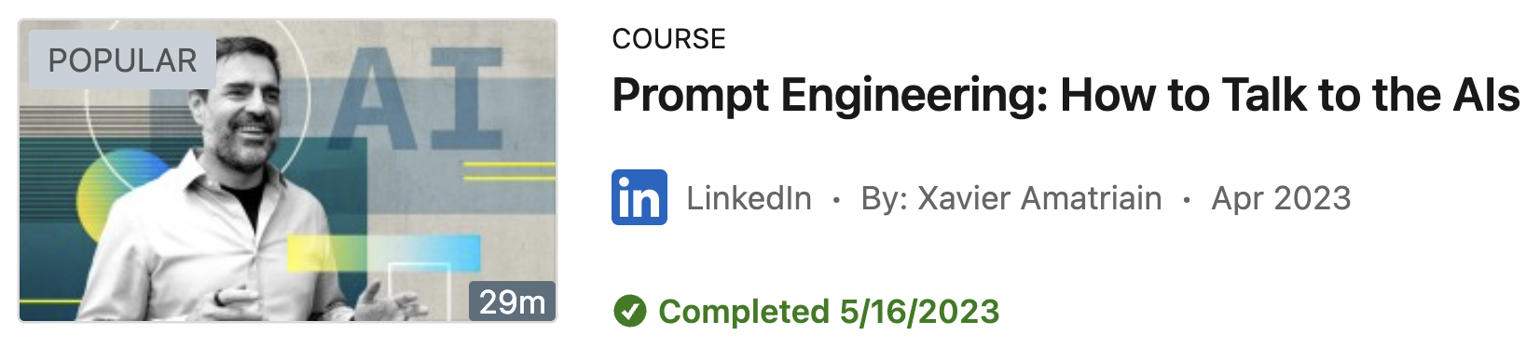
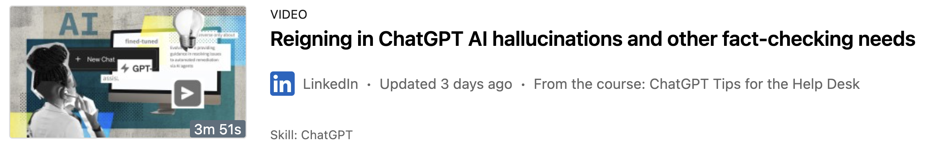
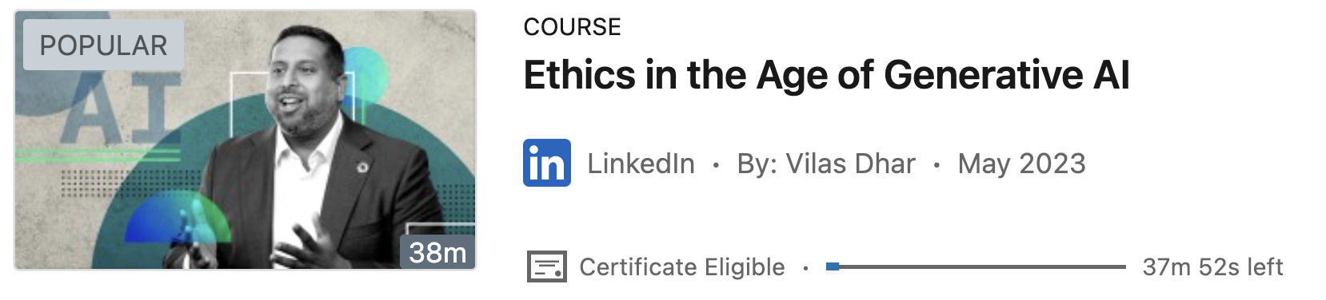
The Minimum AI Requirements Everyone Should Know
Develop Internal Mobility
Applications
Prompt Engineering
Evaluation of AI Output
When to use AI vs Human Intelligence
How to talk to AI
An understanding of how to use AI within your workflow responsibly
Ethics & Risks
Notes:
Deep Dive on products listed:
Talent Insights: LinkedIn Talent Insights leverages the power of LinkedIn’s Skills Graph and Skills Taxonomy to map out how an organization’s employees and skills are related, allowing you to uncover skill gaps, flag employee attrition, and discover and build career pathing opportunities.
Skill Insights: Allows organizations without LTI to uncover skill insights within LinkedIn Learning, mapping out how employees, skills, and learning are related.
Career Goal Setting: Help employees navigate internal career paths by surfacing career development opportunities based on individual goals. Learners can pick between two career goals: grow in current role and change career paths. If they want to change paths, they will need to input the role name they want to transition to. From there, they can click directly into relevant content, which will live in a new “My Plan” page on My Learning. At launch, they will see a new module of career development content.(ex/ create a career plan, find a mentor, etc.) based on their goal. In the future, this page will also house jobs at your company and Career Guides
Role Guides: New career guides are geared towards helping your employees advance within or to specific roles at your company. They will bring the best of LinkedIn Learning and LinkedIn together to help learners build the skills they need to perform certain roles at your company, as well as immerse themselves in the function with LinkedIn communities, posts from industry experts, and pre-certifications. For instance, if you have an employee that wants to become a Project Manager at your company, they can leverage these pages to build the skills and knowledge they need to make that switch. They can also be a great resource for early career Project Managers who want to build the basics in order to advance within their current role To start, we’re offering seventeen roles that will be customizable to your organization
Skill Evaluations: Learners can understand skill proficiency and gaps in order to guide learning and receive personalized recommendations. At launch, we’re offering self assessments for the top 40 in-demand skills. Learners can complete the assessment by rating themselves against criteria—curated by our industry experts. The results will help learners better understand their specific skill proficiency and gaps, then surface recommended learning content based on their level.
Jobs at your Company: Promote internal mobility by surfacing job opportunities to employees based on their career goals. If an employee is contemplating a career move and doesn’t see a path at their company—or even if they’re just browsing potential career paths—they’re likely already looking at external job opportunities. But often, they aren’t even aware of internal opportunities that could be a good fit for their skills. That’s why we’re investing in bringing jobs from your company into the LinkedIn Learning Hub experience—to increase visibility of these opportunities on a platform where employees already go to develop new skills and advance professionally. And because these jobs will be pulled directly from LinkedIn, jobs that are already posted externally will automatically show up within LiL. That means no new ATS or HRIS integrations or manual job entry required to surface jobs within your LXP
Internal Candidate Spotlight: Spotlight feature in Recruiter that allows recruiters to discover qualified internal candidates easily with a special badge.

Slide 7





LinkedIn Learning is the only content tool that sits on top of the world’s largest professional data set
Today's environment requires putting learners at the center of our strategy. LinkedIn Learning is designed for engagement:
8,400 UTA employees and ~27,000 UTA students already have LinkedIn profiles, our campus LinkedIn Learning account is being pushed to them from us and LinkedIn directly.
The easy content search, AI driven recommendations, and AI content coaching are unmatched, suggesting the right content to the right users in a scalable model.
Learners crave community. The ability to publicly endorse, view, connect, communicate and rate courses brings users together and encourages engagement.
65M
Job Seekers
Weekly
67M
Companies
41K
Skills
1B
Members
Course
Recommendations
Learners receive tailored course suggestions based on trends in their role and industry
22K
Courses
Learning
Roadmap
Learning courses developed based on real time Industry and skill trends
A Social & Connected Ecosystem
Social learning tools with the ability to easily sync badges earned
UTA is a Microsoft campus and LinkedIn is wholly owned by Microsoft. The LinkedIn Learning tools are integrated into our SSO, HRIS, LMS, and our Microsoft tools including Teams and even Viva for the future
Note: Last updated 3/2024 based on the latest available January 2024 global statistics.
Notes:
Unlock value at scale across the lifecycle with the Talent Enterprise program, LinkedIn’s most comprehensive solution to help costumes develop talent lifecycle strategies to support their hiring and learning objectives.
The Talent Enterprise Program brings together LinkedIn’s most comprehensive talent solutions, including:
Hiring Enterprise Program: An exclusive way to partner with LinkedIn, designed to provide flexibility and unlimited access to Recruiter and Jobs, while bringing your entire hiring team together more efficiently. HEP allows Recruiter access to anyone involved with hiring and enables companies to post all jobs without limits at a single price, helping accelerate hiring without complex contracts.
LinkedIn Talent Insights helps customers answer tough talent questions with data-driven insights. The program allows users to gain a competitive advantage in the marketplace by instantly seeing trends and movements across the talent marketplace to inform key business decisions with talent data from the largest professional network.
The Learning Enterprise Program (LEP) is our most cost-effective solution to scale access to LinkedIn’s high quality learning content to your employees and accelerate skill-building at your organization. This program will build a culture of learning that extends to all functions without the hassle of complex contracts. Ultimately, this dedicated investment in learning will maximize the impact of learning initiatives over time and help you build for the future. Most importantly, as an LEP customer, you can democratize learning as a benefit for all - creating a more engaged, empowered, and equitable workforce.
<<Note that Glint will be transitioned to Microsoft in FY24 and given the transition timeline is not included here.>>
We have a unique vantage point at LinkedIn, as the world’s largest professional network, we’re able to map our members’ collective career journeys across the entire talent lifecycle and share these insights with you, helping you to connect the dots between your own hiring, development and engagement strategy.
We call this map the Economic Graph, our vision is to effectively map the world’s economy with a digital representation of every member of the global workforce, every company and job available, and the skills required to get those jobs, representing a holistic look at the career journeys and talent trends of the global workforce. The Economic Graph consists of the data and connections that exist between our 900 million members, 61 million companies, 49 million weekly job seekers, 39K skills and 20K courses.
Access to this information gives us a unique advantage; This data and insights from the Economic Graph flows directly into our talent products in a number of different ways. For example:
With our Talent Insights product, we can provide you with real-time visibility into hiring and skill trends to inform your recruitment strategy and provide 360-degree benchmarking on your organization compared to industry and talent competitors.
On the learning side, we’re able to see what skills are trending on our members’ profiles and adapt our learning content roadmap to make sure you have the most up-to-date learning content that your organization needs.
With LinkedIn Jobs, we’re able to recommend jobs to members with the right skills and experience for the job, even if they aren’t actively looking for that job on the site.

Slide 8

Build Critical Skills
Your Current LiL Usage
Top skills learners are developing at The University of Texas at Arlington
Top skills learners are developing among your peers
Time Period: Past 12 Months (March 2023 – February 2024), Peers: Dallas College, Southern Methodist University, Tarrant County College, Texas A&M University, Texas A&M University-Commerce, Texas Christian University, Texas Woman's University, The University of Texas at Dallas, University of North Texas (note: if there is insufficient peer data, peer data will reflect top developed skills across similar companies in your industry / size of buy), Region: North America, Function: (All), Skill Cluster: (All). Globally, the connected profile bound rate is 51%.
Notes:
Talk Track:
We can also drill down into the individual skills your learners are developing vs. peers. Over the selected time period, we can see that X, Y and Z are your top skills developed, while X, Y and Z are the skills developed among your closest peers.
Questions
Are there any skills that surprise you here?
Are there any skills that your peers are focused on that you are not? And vice versa?
Methodology
The skills included on this slide are tied to enterprise learning courses only, and are based on skills mapped to videos viewed for any amount of time, includes skills mapped to custom content​.
The skills included on this slide are at the individual skill level – the most granular level of skill.
Peer data will only load if there is sufficient data; otherwise by default the peer graph will populate with the top skills learners are developing in your client’s industry / LiL size of buy cohort.
Methodology change that slightly differs from the legacy LVR and current LSR; impact is negligible and insights remain directionally accurate.
What changed? The LVR only counts developed skills from learning activity conducted within the LiL product. The legacy LSR and the Skills Developed dashboard in Merlin count developed skills from the learning activity conducted within the LiL product + the learning activity conducted within the flagship feed.
The skills included on this slide can be filtered for a specific skill cluster if selected at report generation
Skill Clusters definition: buckets made up of various individual skills
For a more detailed definition of each of the skill cluster buckets, check out the Skills Taxonomy dashboard in Merlin: https://merlin.corp.linkedin.com/accounts/1035/insights/1412?
For more high-level slides on skills, check out the skills microsite (https://microsoft.sharepoint.com/teams/Skills) and/or our skills customer objections guide (https://microsoft.sharepoint.com/teams/ltsInsights2/SitePages/Playbooks-&-Guides.aspx#skills-overview-customer-objections-guide).

Slide 9
Build Critical Skills
Your Fastest Growing Skills
Fastest growing skills in the Higher Education industry
Skill Name
# Learners Developing Skill
Company Rank vs. Peers
Methodology: company rank vs. peers is calculated by comparing your company’s percentage of learners developing fastest growing skills divided by all learners, vs. the same metric across all peers.
Time Period: Past 12 Months (March 2023 – February 2024), Peers: Dallas College, Southern Methodist University, Tarrant County College, Texas A&M University, Texas A&M University-Commerce, Texas Christian University, Texas Woman's University, The University of Texas at Dallas, University of North Texas, Region: North America, Function: (All). Globally, the connected profile bound rate is 51%.
Notes:
Talk Track:
Let’s see how your learners are continuing to upskill in new areas. We can look at the fastest growing skills in your company’s industry to see how you rank vs. peers. The fastest growing skills in your industry are defined as the skills that had the greatest YoY growth in members adding a particular skill to their profile. We can look and see how your learners are developing these skills, in order to understand how your learners are keeping pace with industry trends.
Questions
Are your learners focusing in on the right skills that’ll set your company up for the future? Any surprises? How does this compare to your peers?
Methodology
Metrics
# Learners Developing Skill: unique # of learners developing skill during the selected time period.
Company Rank vs. Peers: calculated by comparing your company’s percentage of learners developing fastest growing skills divided by all learners, vs. the same metric across all peers.
Note: data may not populate if there is an insufficient sample size either at the company level or across the peer comparison cohort.
Why? Fast growing skills are by definition hot skills that may be new to an industry; for that reason, LiL content as well as content across our competitors may lag as content creators catch up in creating new content to address these fast growing skills.
Skills:
The skills included on this slide are tied to enterprise learning courses only, and are based on skills mapped to videos viewed for any amount of time, includes skills mapped to custom content​.
The skills included on this slide are at the individual skill level – the most granular level of skill.
Fastest growing skills are defined as skills that had the greatest YoY growth in members adding a particular skill to their profile.
Throughout our Merlin assets, we track the top 10 fastest growing skills are by industry; this insight shows the top 5 fastest growing skills within your company’s industry in which your learners have been investing in the most.
For more high-level slides on skills, check out the skills microsite (https://microsoft.sharepoint.com/teams/Skills) and/or our skills customer objections guide (https://microsoft.sharepoint.com/teams/ltsInsights2/SitePages/Playbooks-&-Guides.aspx#skills-overview-customer-objections-guide).

Slide 10
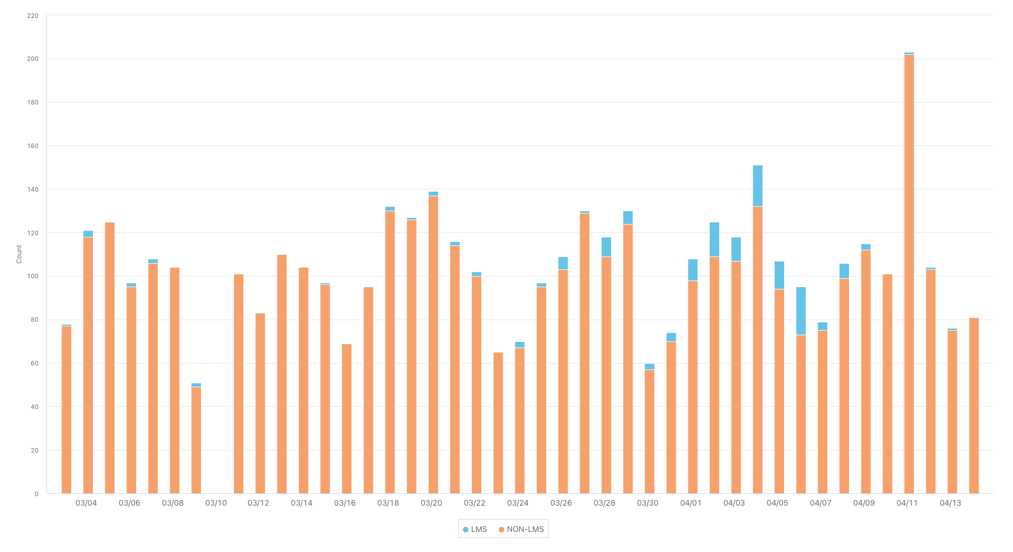
LinkedIn Learning Access Data
From March 3 through April 15, 96% of learners were accessing LinkedIn Learning directly through the platform and 4% of learners were accessing it through integrations.
Number of Learners
Accessed via LiL
Accessed via Integration
Data has been pulled from 3/3 through 4/15

Slide 11
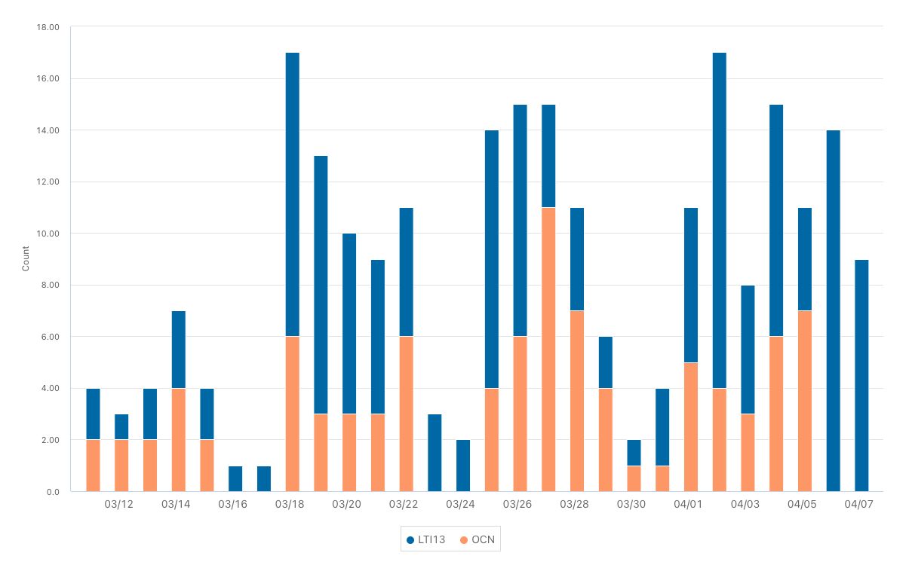
LinkedIn Learning Access Data
A different large, public TX University
Number of Learners
Accessed via LiL
Accessed via Integration

Slide 12

Blended Learning Features
Learn Anywhere
You’re in Control
24/7 Access on computer, tablet or mobile
Pause and continue where you left off
Accessibility
Choose playback speed
Closed captioning
Keyword search in transcript
Offline & audio only options
Accessible to All Learners
Q&A
with Instructor
Notebook
Exercise Files
Reinforce and Boost Learning
Take time stamped notes while watching for later
These are completely private
Many courses include these to help you practice what you learn in real-time
If connected, see Q&A from other viewers or submit your own question to the instructor
Notes:
LinkedIn Learning is available on demand whenever it is convenient for you to learn.
You’re in control of how you engage with the content on LinkedIn Learning, playback speed, audio only mode, closed captioning, keyword search in the transcript
Q&A allows learners who have connected to their LinkedIn profile to ask questions of the LinkedIn Learning instructor
Notebook provides a place to take time stamped notes to easily go back and review
Courses provide exercise files for activities to help reinforce learning or practice files where you can practice along side the instructor.

Slide 13
Showcase Growth…
Notes:
Once you complete courses or learning paths on LinkedIn Learning you will want to show off your progress by adding those certificates to your LinkedIn profile.
This is a great way to get endorsed for your strengths and build both through leadership and add to your professional brand
click to next slide
You can see that not all badges need or should be from LinkedIn that you add to your profile, but it’s a really great option.

Slide 14
Broad Content Options for Supplementation with LinkedIn Learning
Courses
Each LinkedIn Learning course is built with micro-learning in mind. Take the courses slow through each video and chapter. Once you complete the course, add your certificate to your LinkedIn profile.
Learning Paths
Take the guessing out of your learning direction with learning journeys for a variety of skill levels, new roles, or general skill advancement.
& More
Role Guides Documentaries Practice Environments
Audio Only Live & Recorded Webinars
Check out the Content Corner
Notes:
For those of you who are brand new to LinkedIn Learning, I want to talk a little bit about what you can expect from the actual content…
We have many different flavors of content, first and foremost are the courses. <CLICK FOR ANIMATION>
Each course is broken down into short videos and chapters, with videos ranging in time from 3-7 minutes long. The content philosophy here has micro-learning at the center. We want you to be able to jump into any video within any course and learn at least one thing from each individual video.
<CLICK FOR ANIMATION>
I’ve also mentioned Learning Paths a few times. These are simply designed learning journeys that include a handful of courses to help you build foundational skills or work on a general competency.
<CLICK FOR ANIMATION>
Let’s be honest, we have such a breadth of content available, that it can be overwhelming to navigate or guide folks to learning. We have built out many Skills Maps or Repositories. These are especially great for supervisors or designing programs around desired skills. Check out the Content Corner to explore these in further detail and see what is new.

Slide 15
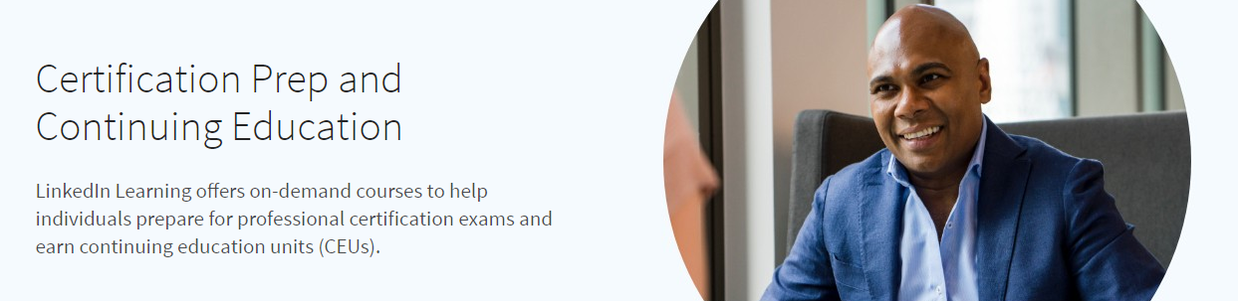
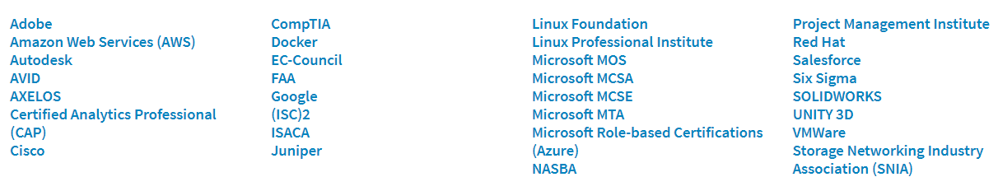
*Use this link to find the full list of certification and associated course list.

Slide 16

IMPORTANT NOTES BEFORE PRESENTING:
Rep Directions: This is the ideal slide as it most speaks to value, at an account level. But, if numbers are not ideal (i.e. learner value is lower than non-learner value), delete the bubble/insight.
LiL is helping your students
1.08x
More likely to be hired after graduation
1.7x
More first-degree connections
7.9x
More jobs for which they have applied
Notes:
Talk Track
The good news, we see students who use LinkedIn Learning getting hired at a higher rate and for the desired jobs for which they have applied.
Now, it's a matter of getting non-learners to use LinkedIn Learning to achieve similar employability outcomes as their peers.
Methodology
Note:
A 'student learner' is defined as a LinkedIn Learning User (both Enterprise & Consumer) who satisfies at least one of the two following conditions:
(A) watched at least 5 minutes of content within one year of graduating OR
(B) logged in >5 days within one year of graduating.

Slide 17


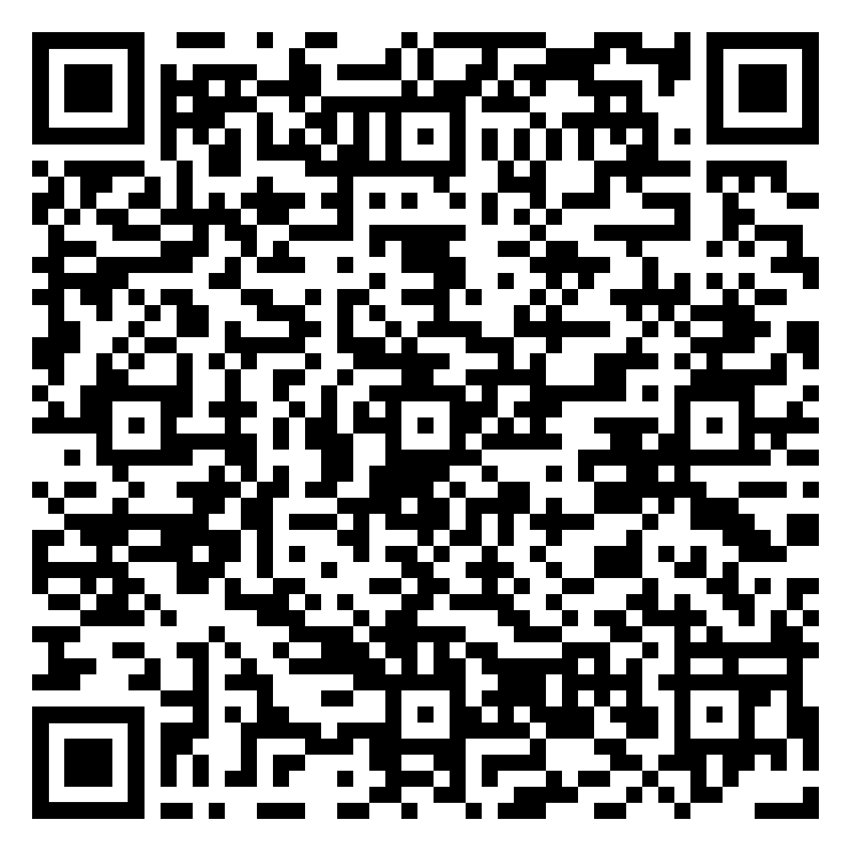
Faculty Use Cases
We want LinkedIn Learning to be an approachable and useful tool for all instructors at your campus
Real-life Examples in the Classroom
Flipped Classroom
& Zero Textbook Costs
Blended Classroom Experiences
LinkedIn Learning courses provide more real-world applications and broaden student perspectives
Fox Valley Technical College leverages hands-on LiL content for 22 of their courses and certification programs
Students interviewed said while they don’t particularly love learning from a textbook, [however] retaining the information from LinkedIn Learning videos was much easier and more enjoyable.
The new business program at University of Central Florida is celebrated as the most popular since they eliminated textbooks, reduced lecture times, and do not give exams for memorization.
These features help enhance learning objectives for students:
Completely flipped classrooms
Emphasizing foundational soft skills
Collaborative focus on projects, over solo assignments
Required in-demand skills courses
LinkedIn Learning provides a bridge to what students learn in school to what they’ll do in their work after graduation.
Lambton College, in Ontario, Canada, has simplified this approach for its students through department deans and faculty course recommendations to supplement as many classes as possible.
For example, Lambton used a 1:1 mapping for their project management courses. Allowing students to easily earn badges for these aligned
topics.
Notes:
REGGIE
As we mentioned, the goal for today’s session is to help you understand what’s in it for you and your students. AND how approachable LinkedIn Learning is to adopt into your classrooms.
Don’t take it from us, here are a few examples where faculty are leveraging LinkedIn Learning to enhance their class with supplemental material.
<CLICK ANIMATION>
For our first example, let’s travel to Wisconsin where Fox Valley Technical College leverages hands-on LinkedIn Learning courses for 22 of their programs and certificate courses.
The LiL videos included, provide students with additional perspectives on the curriculum, and examples of real-world applications of the skills and topics they are learning about.
In interviews with LinkedIn, students even said that although they don’t always love learning from textbooks, retaining the information from the LinkedIn Learning videos was much easier and a more enjoyable experience.
<CLICK ANIMATION>
Jumping over to another example from University of Central Florida, Here are a few things you won’t see in any class that’s part of the Integrated Business Program: A textbook, A professor lecturing to the whole class for more than 15 minutes, Tests of memorization, and Solo assignments.
Instead, the campus has re-centered these courses using a flipped-classroom model to now include: An emphasis on foundational soft skills, collaborative team projects, and a set of supplemental required courses to aid in skill building. These resources are updated continually, cover a wide array of in-demand topics, and feature a diverse set of teaching perspectives.
<CLICK ANIMATION>
Last but not least, let’s go north to our friends at Lambton College in Ontario, Canada.
The concept is simple. Rather than having students dig through the library on their own, deans and faculty members created collections of LinkedIn Learning courses to bridge the gap between what they are learning now and how they will apply it in the future.
An example – For their Project Management curriculum, this campus leverages the full list of certified continuing education courses under the PM subject that faculty can weave easily into their own course structure.
For more on these case studies and best practices check out the QR code links and our follow up resources.

Slide 18


Blending Niche Curriculum
Sample syllabus script
Copy and paste
Campus.
Syllabus script for the perfect fit
LIL 101 COURSE SYLLABUS
Additional Resources:
As a student, you have free access to LinkedIn Learning and over 18,000 courses in business, creative, and technology subjects. Login here: [Insert School Custom Login Link/Instructions]
These course recommendations can be used to help you during class projects or while using the required technology programs. Also, be sure to add any completed LinkedIn Learning skills and certifications to your LinkedIn profile to showcase your earned skills.
Course Recommendations:
  Excel Tips Weekly
  Working and Collaborating Virtually
  The Most In-Demand Soft Skills That Everyone Should Know
While there is a TON of LinkedIn Learning content, it won’t always fit niche course curriculum perfectly. In those instances, providing LinkedIn as an excess tool or resources is a great way to support your students’ academic success.
Recommended courses that can support technical programs or writing styles that might come up throughout the semester
Provide students with a professional branding tool by reminding them to add their learned skills and certifications to their LinkedIn profiles
Interested to supplement curriculum with LinkedIn Learning courses? Review the repository or fill out the Mapping Template request form
Notes:
REGGIE
If you are hearing a lot of examples that don’t feel like they apply to the niche curriculum you explore with your students, not to worry.
LinkedIn Learning is not just a use it or lose it tool! By providing recommended courses for software uses, career preparation, or other additional resources, students will have the opportunity to lean more heavily into becoming successful students. If you have worked with me before you know I say this often, but I was personally a student at a university with full campus access to LinkedIn Learning (Lynda.com in those old days) and I had no idea until I started working for this company!
We have created this script if you are interested in adding this as one more Additional Resources items on your Syllabus. Help guide students to more tools and resources. OR you can cheat a little and ask students which LinkedIn Learning courses they used during your course evaluations and add those top used recommendations in for next semester.

Slide 19

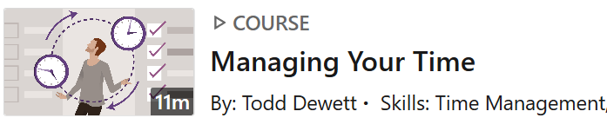

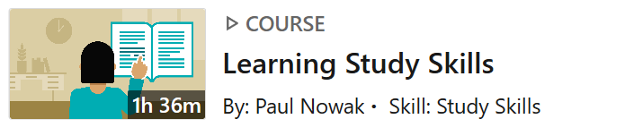
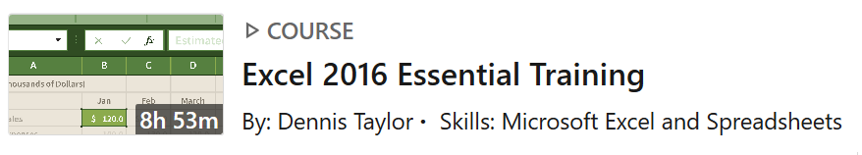
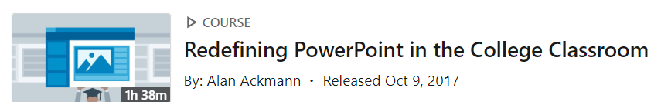
Example of Supplemental Skills
Notes:
Here are a few course examples of the supplemental skills available on LinkedIn Learning
We’ve also completed a skills map that aligns LinkedIn Learning content to the NACE Competencies to further assist with supporting students in developing those essential career readiness competencies.

Slide 20
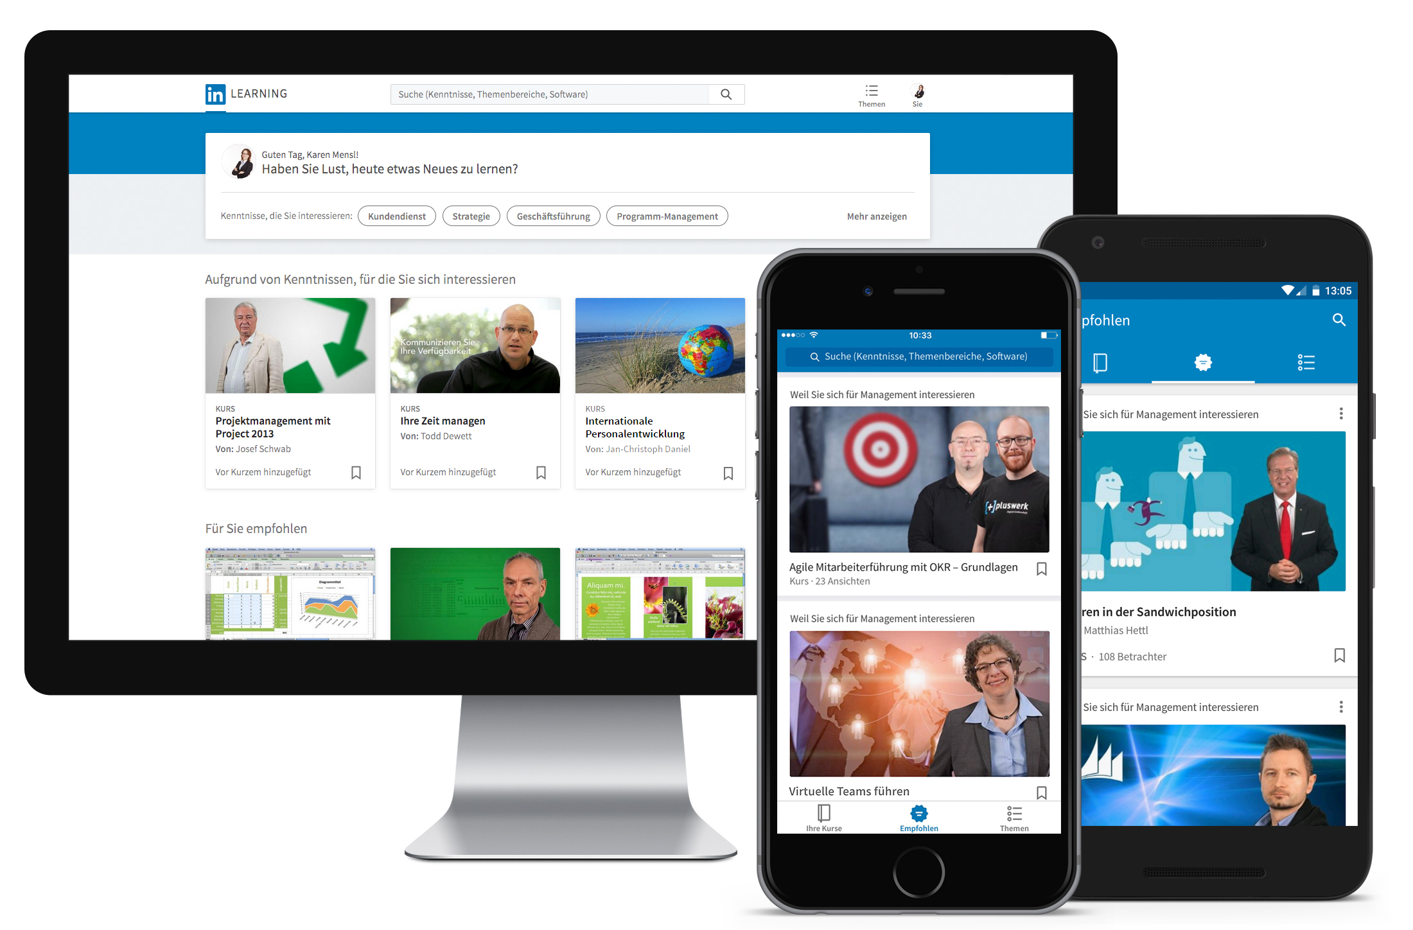
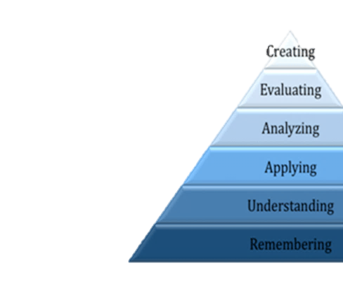

Flipping Your Classroom
Students take advantage of engaging with topics through courses, videos, and audio-listening
Class time is transformed to engaging discussions, learning from each other, and asking questions
Notes:
Click for animations (2)
When we thinking about LinkedIn Learning in regard to Bloom’s Taxonomy instructors can use a flipped classroom approach using LinkedIn Learning content to supplement the create, evaluate and analyze stages and allow for deeper in person or virtual conversations in the classroom.

Slide 21
Content Mapping & Resources
Notes:
Before we dive into the instructor experience with D2L and LiL. I’d like to share some resource available to support you with finding the content to meet your needs
So, once you get into your LinkedIn Learning the adventure can officially begin.

Slide 22
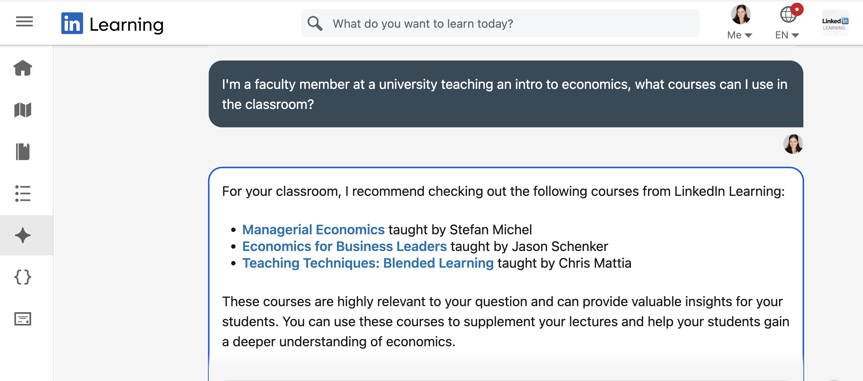

Slide 23


Course Mapping 101
Required Skills
Achieved Skills
Critical Thinking Skills
Supplemental Resources:
LiL Courses/Videos, Custom Content, Learning Paths
Course Completion
Communication Skills
Project and topic retention
Presentation Skills
Online Project Portfolio
Organizational Skills
Articulated transferable skills
Getting Started
1
Identify your course learning objectives using your syllabus, textbook needs, etc.
2
Check the Academic Mapping Repository, to see if course mappings already exist for your curriculum OR submit a custom mapping request
3
Build your custom learner journeys directly on LiL*, or use the search capabilities in D2L to locate and add content directly to your course.

Slide 24




Content Mapping
These mapping collections provide a great starting point for identifying supplemental courses. If you are looking for custom alignment, we do offer free services to map your curriculum 1:1 with LinkedIn Learning. Fill out the Custom Mapping Template & submit to your Customer Success Manager for support.
All Academic Subjects
Mapping Links
Leadership & Manager Development
Content | Learning Paths
Diversity. Equity & Inclusion
Content | Learning Paths
Student Career Preparedness
Journeys & NACE Competencies
Upskilling with Digital Transformation
Content | Learning Paths
Employee Performance Reviews & Support
Content | Learning Paths
Notes:
REGGIE
With so many courses available it can be super overwhelming to know where to even start with LinkedIn Learning.
While we do recommend you start exploring content and using the filters available for searching-either within the d2l instructor experience OR directly on your LinkedIn Learning account- our Curriculum Mapping services and resources are another FREE and awesome tool to support you.
Our repository of content maps include previously mapped college courses, courses mapped to standard competencies or roles, and general education requests that have been made in the past. Don’t reinvent the wheel, just leverage our mapping resources!
If you still can’t find the content you are looking for or get a little lost, we also offer free Custom Mapping services. Just fill out the Request Form and submit it to your LinkedIn Learning Administrator or your Customer Success Manager and our team will complete a course recommendation list in a matter of weeks.

Slide 25




