Slide 1
Resident Assistant Recruitment Interest Session
Building better communities!

Slide 2
Who Are Resident Assistants?
RAs are student staff members who are expected to play a variety of constantly changing roles and are responsible for creating and maintaining a residential environment that is conducive to living and learning.
Each RA must be flexible and creative in meeting the residents’ needs by serving as a:
role model
mediator
university resource
advisor
community developer
programmer
educator
mentor
friend

Slide 3
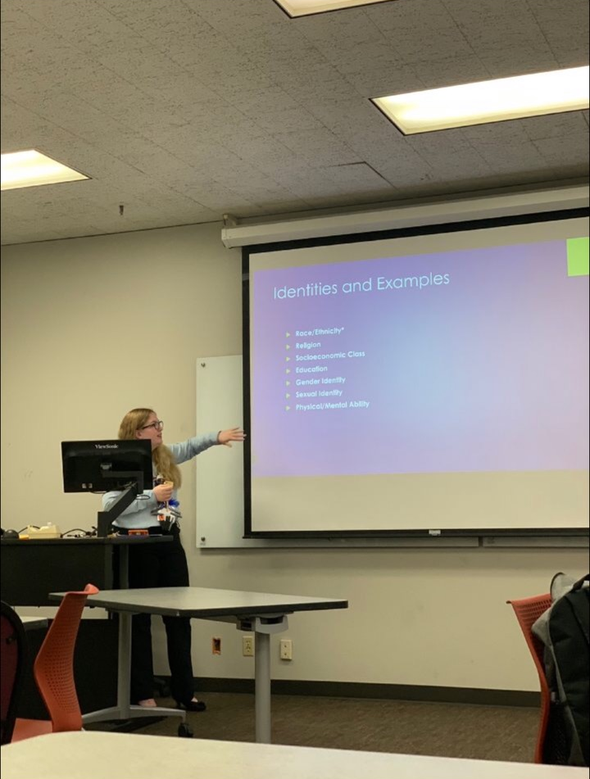
Requirements for Application
Live on Requirement
2 semesters of living on campus by the end of Spring 2023
UTA residence hall or UTA on-campus apartment
GPA Requirement
2.50 – Cumulative GPA at time of application
2.00 – Fall 2022 Semester GPA
Disciplinary Status Requirement
in good standing with Office of Community Standards & Apartment & Residence Life
Housing
Rent & meal plan paid and current which can vary.
Notes:
Studying pic?

Slide 4
Renumeration
 | Residence Halls | Apartments
Stipend | Paycheck: $577/month* | Paycheck: $727/month*
Rent | Receive Private without 1.7x Arlington, KC, West & Vandergriff – Arlington Double Rent minus $500 for the year | Ability to choose a roommate with the exception of Heights on Pecan 45% rental reduction East and West Campus – 1 bedroom, 1 bath, unfurnished Timber Brook and the Heights – efficiency/1 bath, fully furnished
Meal Plan | Orange Meal Plan Provided | No Meal Plan
*Compensation based on employment during the academic year (Winter Break and Summer employment available in select communities.) 2023-2024 benefits have not yet been finalized Compensation subject to change at the discretion of the department.

Slide 5
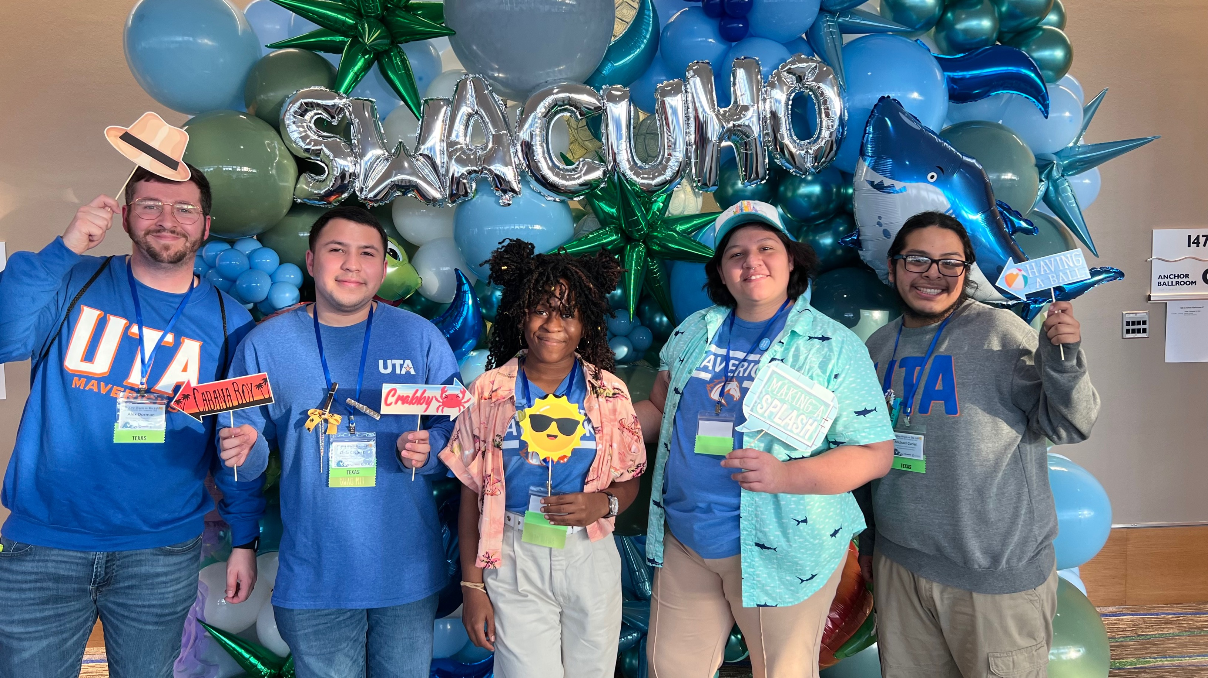
Benefits (continued)
Personal and Professional development opportunities:
Training & developing transferable skills in communication, conflict mediation, goal setting, and working in a team, just to name a few
Leadership opportunities provided through conference attendance (Leadership Retreat, RA conference) and departmental committee involvement
Networking & Making Connections through community development, programming and supporting UTA events

Slide 6
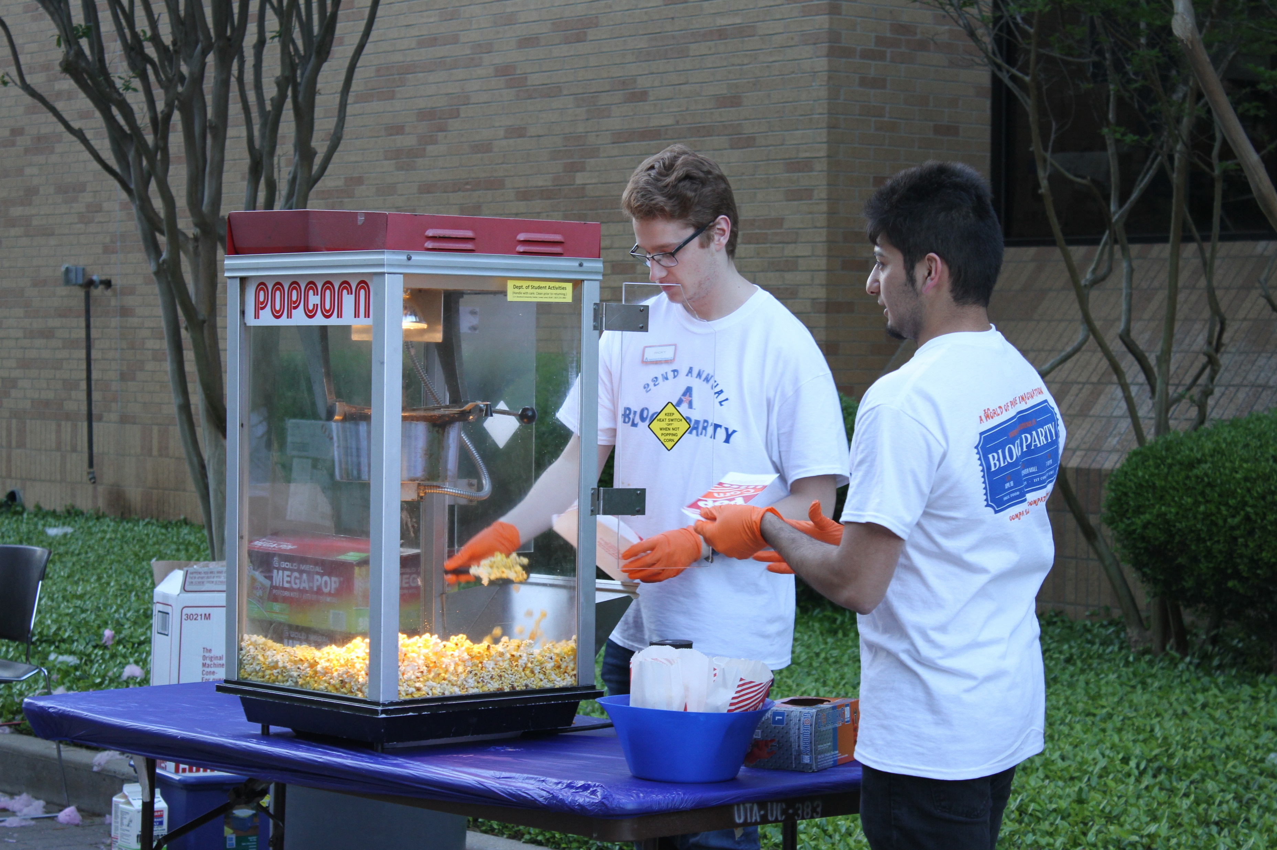
As an RA, you demonstrate Maverick Pride by bringing residents to events like:
Welcome Week events
Oozeball
Bed Races
Halloween Casino Night
Athletic events
Homecoming events
Late Night Breakfast
Block Party
and much more!

Slide 7
 | Apartments | Residence Halls
Employment dates | Through August 1, 2024 * May work holidays/breaks | Through Early May 2024 *RA’s may have the opportunity to work during winter break in certain residence halls.
Additional responsibilities | Newsletters Cleaning inspections Community walks | Door decs Floor/ramp meetings Front desk shift
On Call Shifts | Varies per community. At least 2 Primary and 2 secondary shifts per semester | 1-2 RAs on call per night, depending on community.
Rounds | 3 times per week (Thursday-Sunday) | 2 times per night
Other | Plan events Weekly staff meetings / one-on-one meetings Know your community and residents; visibility Committee participation Bulletin boards

Slide 8
responsibilities
 | Residence Halls | UTA Apartments
Know your residents!
Act as a resource for your residents
Programming
Bulletin Boards/Door Decs → get creative! |  | Bulletin Boards - Door Decs – HOP & TB EC & WC
Weekly Meetings
On-Call Duties
Front Desk Responsibilities
Holiday/Weekend Requirements | Weekends – Some weekends Holiday breaks - Thanksgiving and Spring Break Winter break: RA’s may have the opportunity to work during winter break in certain residence halls. | Some weekend and holiday work is required.

Slide 9
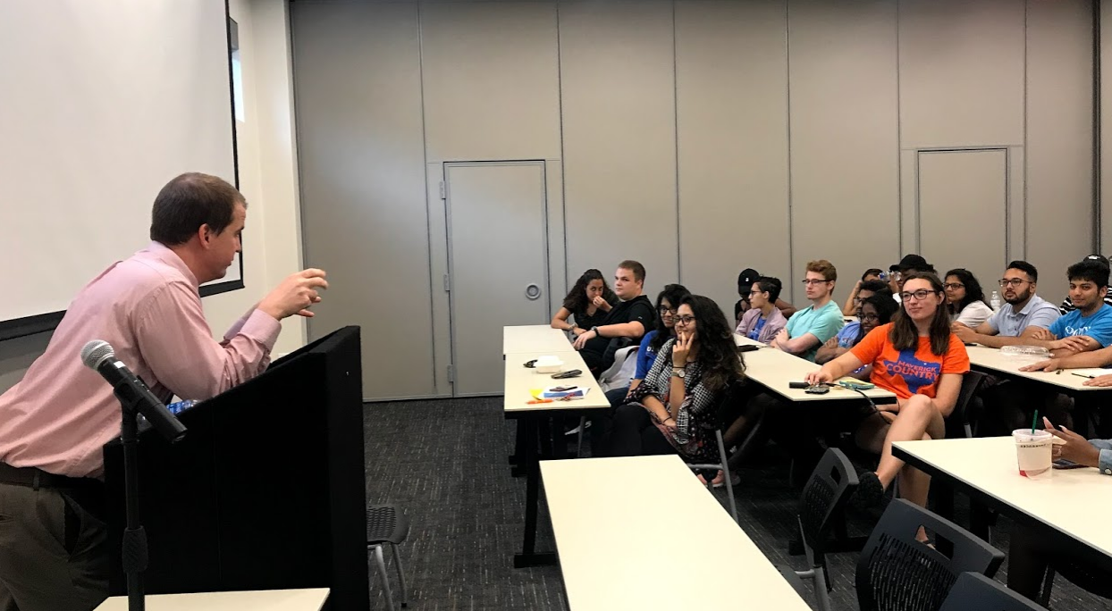
Employment Dates
UTA Apartments and Residence Halls:
Apartment RAs: August 2023 – August 1, 2024
Residence Hall RAs: August 2023 – May 2024 (summer employment may be available)
Must attend a mandatory training at the beginning of August

Slide 10
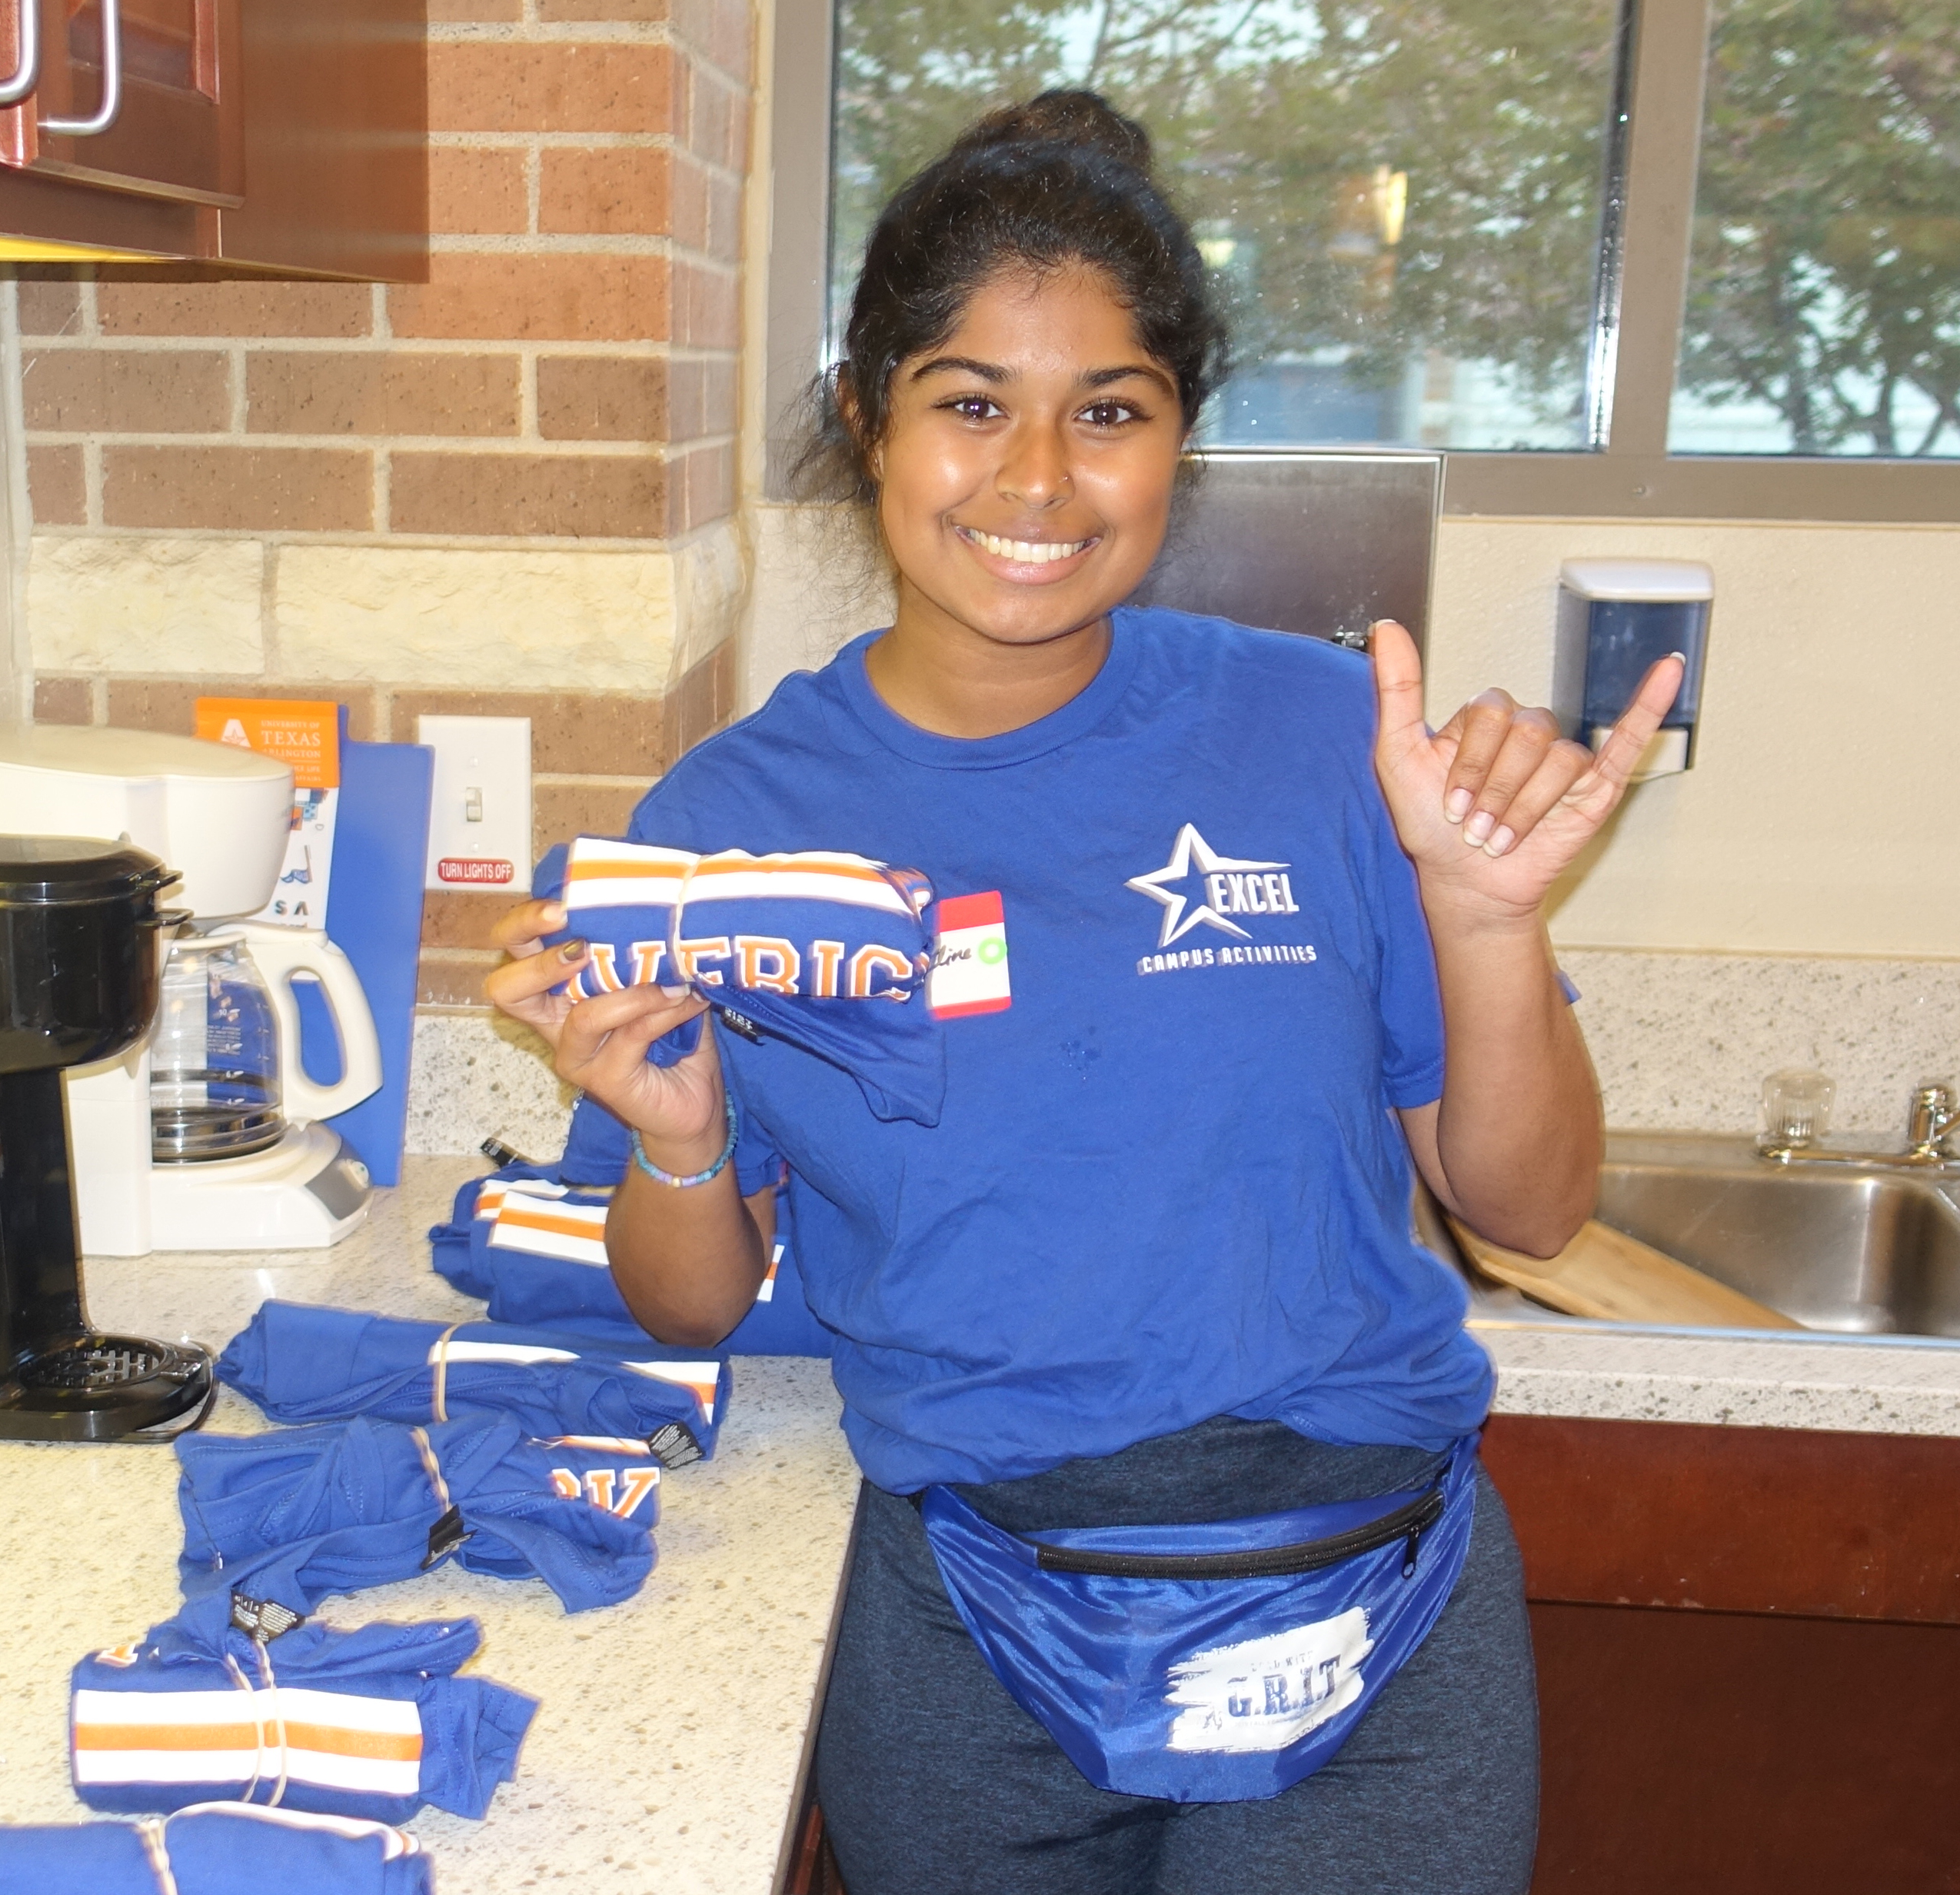
Job Application Details
Apply via Handshake by January 29th at 11:59pm.
Submit a Supplemental Application [uta.erezlife.com] by January 29th at 11:59pm.
Applications are read and reviewed to determine eligible and qualified candidates
Submit 2 References by March 6th at 11:59pm.
Applications Due January 29 at 11:59pm!

Slide 11
Interview Process
If selected to move on in our process, you will be required to attend Interview Day to remain eligible.
Interview Day
You will receive an email if chosen to interview
Candidates will select their interview day and time. Candidates that arrive late will not be interviewed and will not continue in the process
Interviews are to take place March 1st - 3rd
Business casual attire
After the Interview
If selected for a position, you will be notified by March 14-20

Slide 12
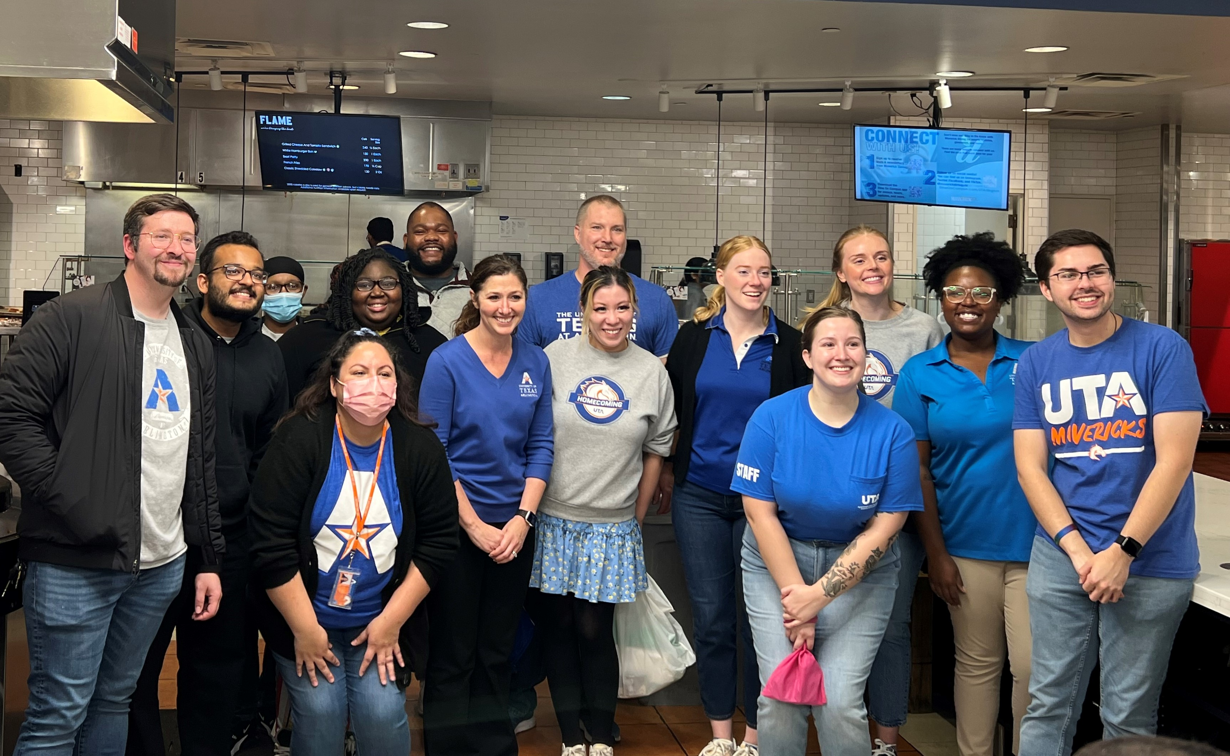
Questions? Email: livingoncampus@uta.edu
Visit: https://www.uta.edu/housing/living/staff/ra.php for more information about the RA position
The Leadership Team, Residence Directors, and Assistant Residence Directors of Apartment and Residence Life.

