Slide 1
Resident Assistant Recruitment Interest Session
Building better communities!

Slide 2
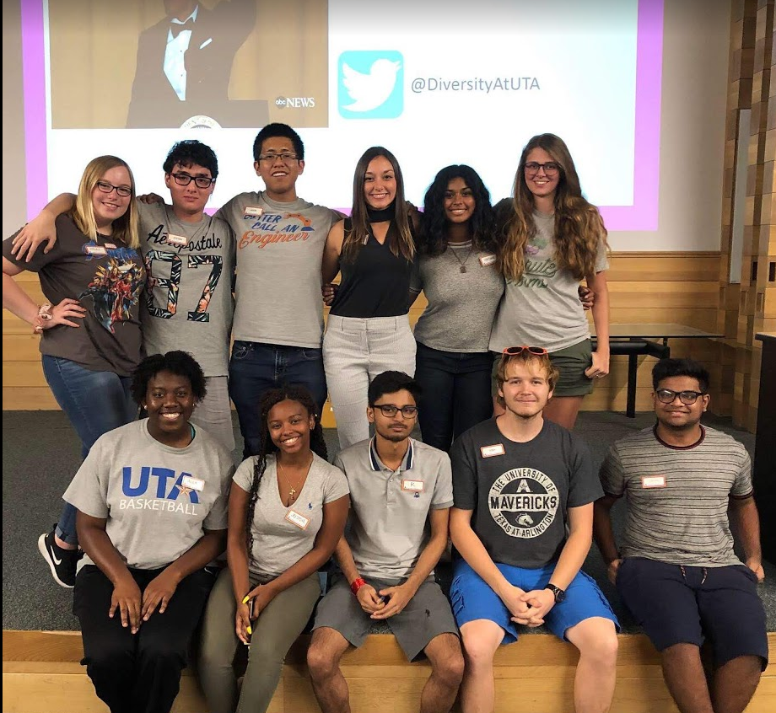
Who Are Resident Assistants?
RAs are student staff members who are expected to play a variety of constantly changing roles and are responsible for creating and maintaining a residential environment that is conducive to living and learning.
Each RA must be flexible and creative in meeting the residents’ needs by serving as a:
role model
mediator
university resource
advisor
community developer
programmer
educator
mentor
friend

Slide 3
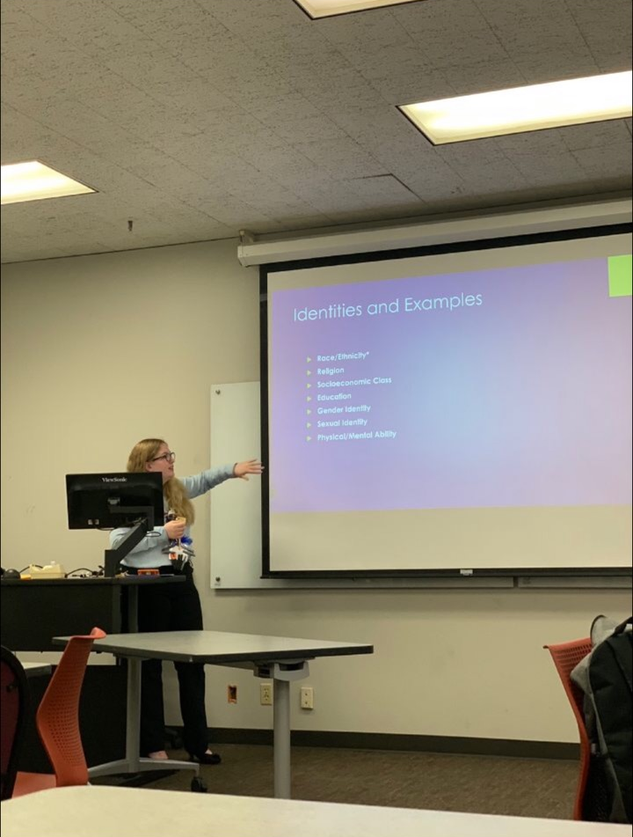
Requirements for Application
Live on Requirement
2 semesters of living on campus by the end of Spring 2021
UTA residence hall or UTA on-campus apartment or Centennial Court
GPA Requirement
2.50 – Cumulative GPA at time of application
2.00 – Fall 2020 Semester GPA
Disciplinary Status Requirement
in good standing with Office of Community Standards & Apartment & Residence Life
Housing
Rent & meal plan paid and current which can vary.
Notes:
Studying pic?

Slide 4
Renumeration
 | Residence Halls | Apartments
Stipend | Paycheck: $552/month* | Paycheck: $702/month*
Rent | Receive Private without 1.7x Arlington, KC, West & Vandergriff – Arlington Double Rent minus $500 for the year | Ability to choose a roommate with the exception of Heights on Pecan 45% rental reduction East and West Campus – 1 bedroom, 1 bath, unfurnished Timber Brook and the Heights – efficiency/1 bath, fully furnished
Meal Plan | Bronze Meal Plan Provided | No Meal Plan
*Compensation based on employment during the academic year (Winter Break and Summer employment available in select communities.) 2021-2022 benefits have not yet been finalized. Compensation subject to change at the discretion of the department.

Slide 5
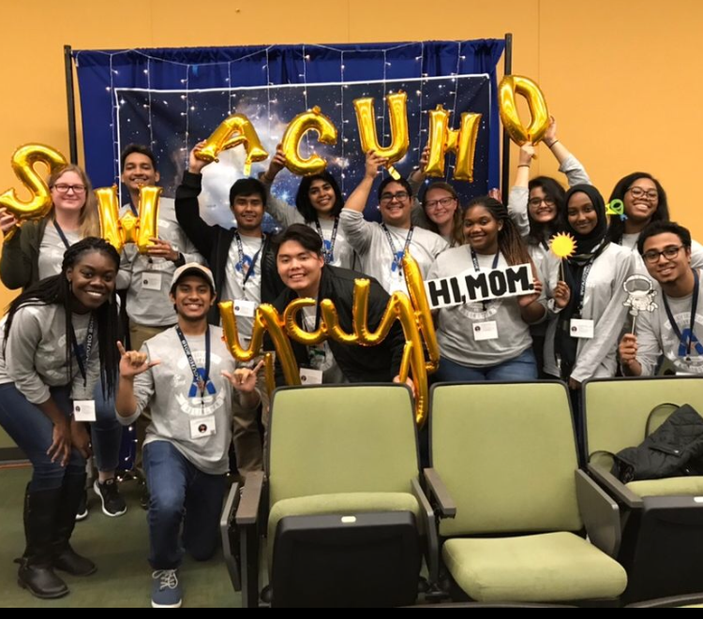
Benefits (continued)
Personal and Professional development opportunities:
Training & developing transferable skills in communication, conflict mediation, goal setting, and working in a team, just to name a few
Leadership opportunities provided through conference attendance (Leadership Retreat, RA conference) and departmental committee involvement
Networking & Making Connections through community development, programming and supporting UTA events

Slide 6
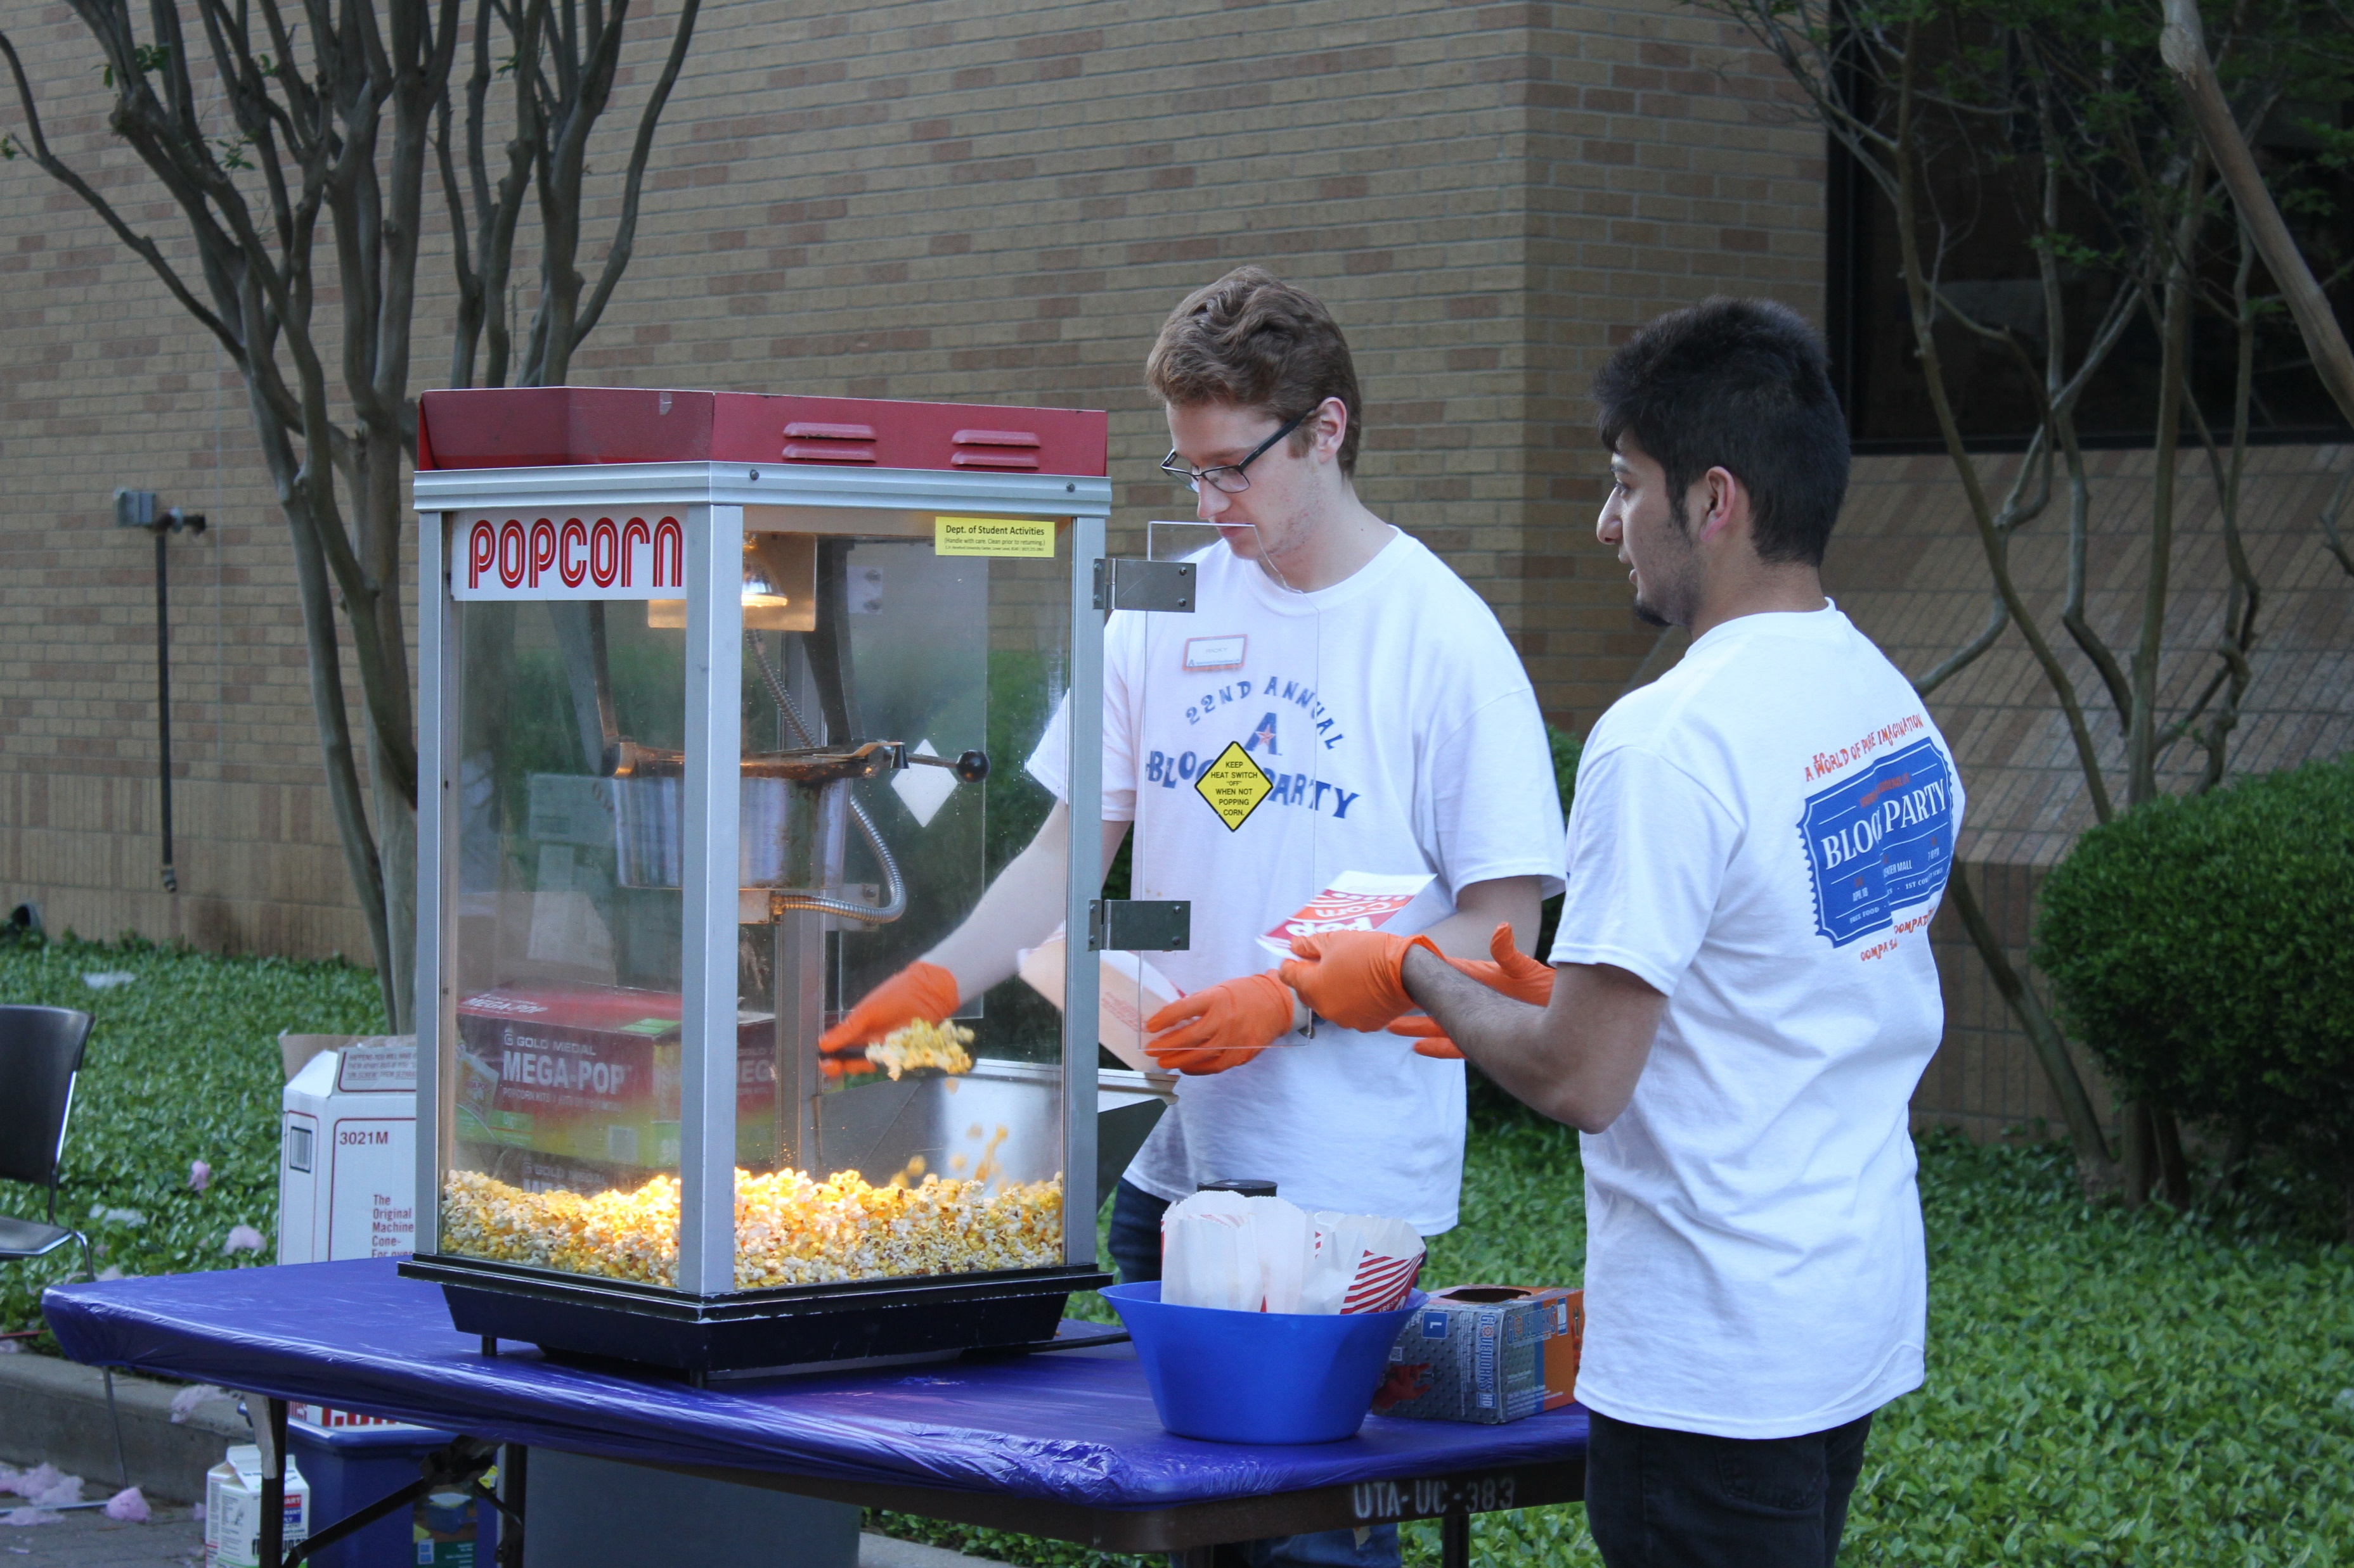
As an RA, you demonstrate Maverick Pride by bringing residents to events like:
Welcome Week events
Oozeball
Bed Races
Halloween Casino Night
Athletic events
Homecoming events
Late Night Breakfast
Block Party
and much more!

Slide 7
 | Apartments | Residence Halls
Employment dates | Through August 1, 2022 * May work holidays/breaks | Through Early May 2022 *RA’s may have the opportunity to work during winter break in certain residence halls.
Additional responsibilities | Newsletters Cleaning inspections Community walks | Door decs Floor/ramp meetings Front desk shift
On Call Shifts | Varies per community. At least 1 Primary and in some communities 1 Secondary as well per shift | 1-2 RAs on call per night, depending on community.
Rounds | 3 times per week (Thursday-Sunday) | 2 times per night
Other | Plan events Weekly staff meetings / one-on-one meetings Know your community and residents; visibility Committee participation Bulletin boards

Slide 8
responsibilities
 | Residence Halls | UTA Apartments
Know your residents!
Act as a resource for your residents
Programming
Bulletin Boards/Door Decs → get creative! |  | Bulletin Boards - Door Decs – HOP & TB EC & WC
Weekly Meetings
On-Call Duties
Front Desk Responsibilities
Holiday/Weekend Requirements | Weekends – Some weekends Holiday breaks - Thanksgiving and Spring Break Winter break: RA’s may have the opportunity to work during winter break in certain residence halls. | Some weekend and holiday work is required.

Slide 9
COVID Update/Reminders
Although RA Programming has occurred completely virtually this year, we are hopeful to do some in person programming next year.
There is always a potential in the RA job of interacting in person with residents (on call, rounds, inspections, etc.)
ARL does provide protective equipment for RAs if entering apartments/rooms
COVID is always changing, so RAs are expected to be flexible in these unknown conditions.
Note that the RA role may look different than it did this past year.

Slide 10
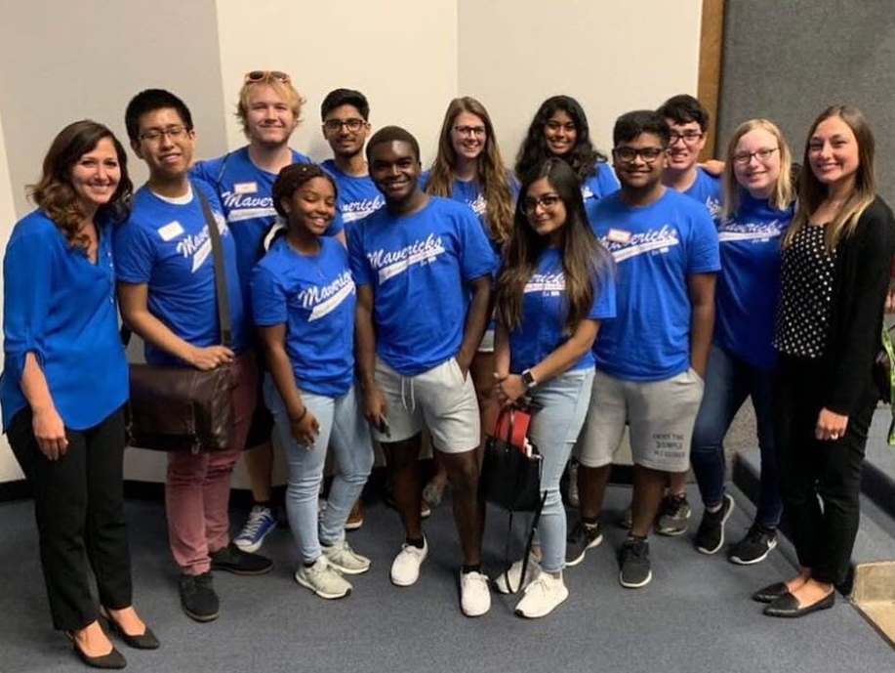
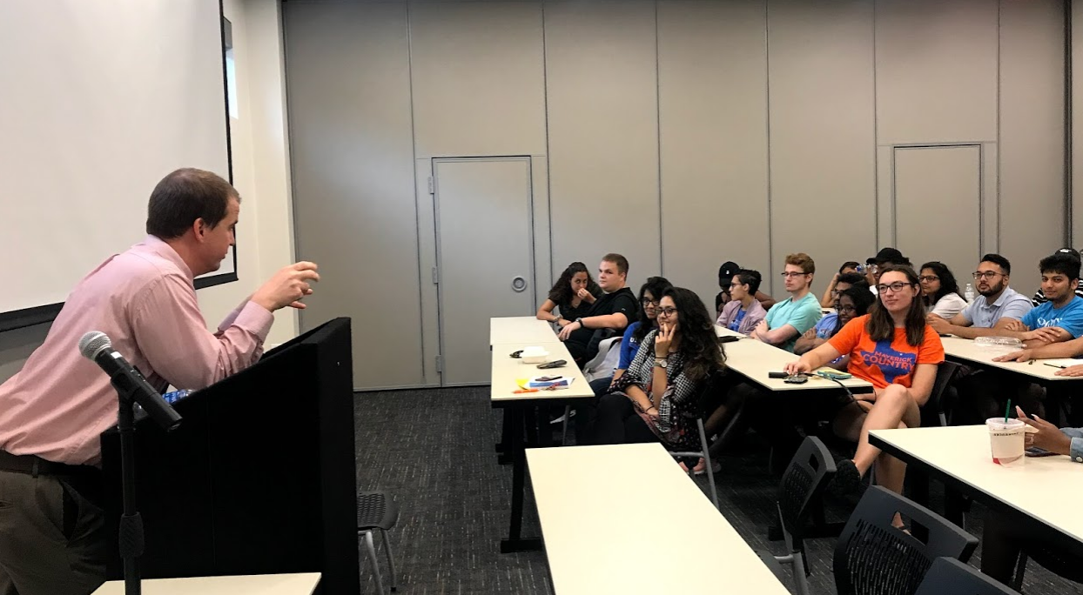
Employment Dates
UTA Apartments and Residence Halls:
Apartment RAs: August 2021 – August 1, 2022
Residence Hall RAs: August 2021 – May 2022
Must attend a mandatory training at the beginning of August

Slide 11
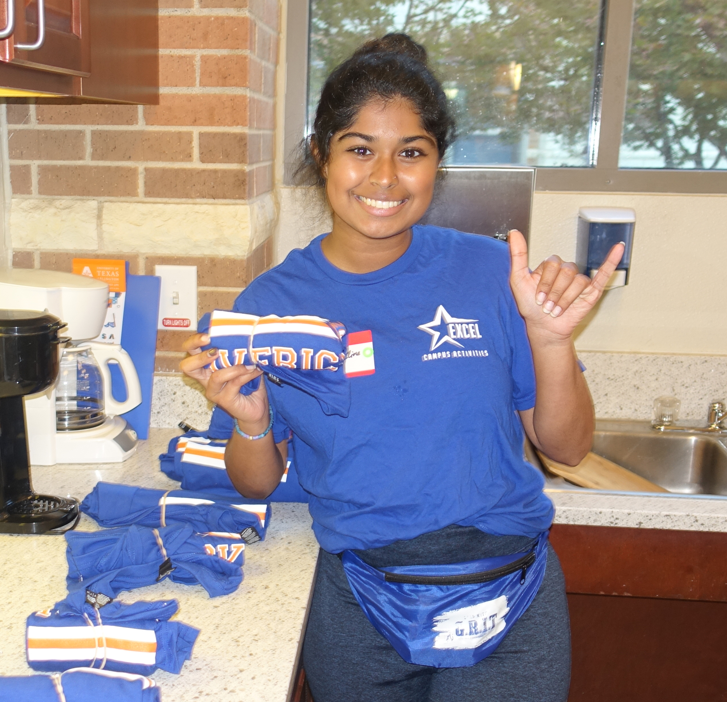
Job Application Details
Apply via Handshake by May 5th at 11:59pm.
Submit a Supplemental Application [uta.erezlife.com] by May 5th at 11:59pm.
Applications are read and reviewed to determine eligible and qualified candidates
Submit 2 References by May 13th at 11:59pm.
Applications Due May 5th at 11:59pm!

Slide 12
Interview Process
If selected to move on in our process, you will be required to attend Interview Day to remain eligible.
Interview Day
You will receive an email if chosen to interview
Candidates will select their interview day and time. Candidates that arrive late will not be interviewed and will not continue in the process
The interview will be held virtually
Business casual attire
After the Interview
If selected for a position, you will be notified by early June

Slide 13
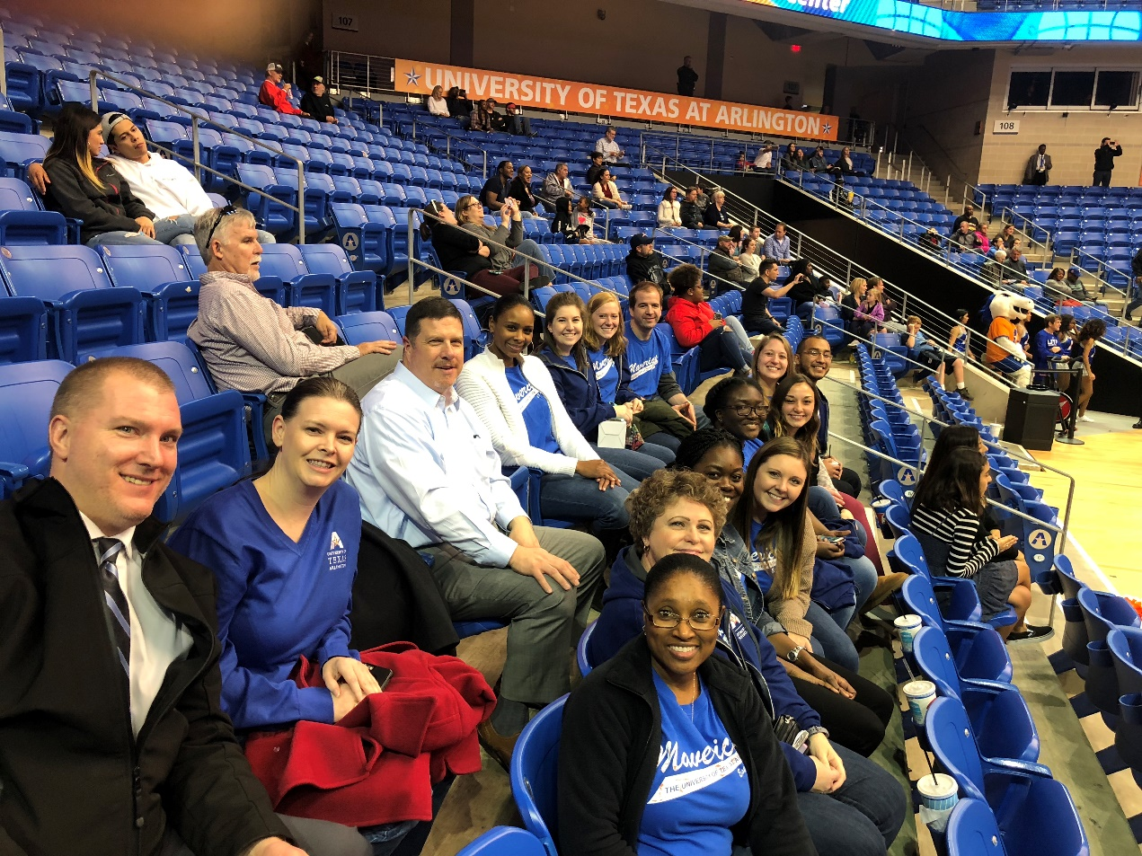
Questions? Email: livingoncampus@uta.edu
Visit: https://www.uta.edu/housing/living/staff/ra.php for more information about the RA position
The Leadership Team, Residence Directors, and Assistant Residence Directors of Apartment and Residence Life.

