Slide 1
Concentration Portfolio Review
(CPR)

Slide 2
What is CPR?
Portfolio Review
An assessment of your artwork by faculty within your specific area to ensure your work is up to standards
Entry Level Review (21/24hr) – to determine if you will officially become an art major for your degree plan
Advanced Level Review (36hr) – BFA majors only, follow-up review to ensure you’re on the right track with your advanced work
*Some areas may only require one CPR, combining Entry & Advanced Review (Cinematic Arts, Design, & Photography may have different hour requirements)
Meets NASAD Accreditation
  In accordance with National Association of Schools of Art and Design (NASAD) accreditation, students within the Art & Art History Department are required to participate in & complete a portfolio review process

Slide 3
When do I go through?
*Most areas: When you’re enrolled in your 7th studio art (artmaking) class
Roughly 21 or 24 hours depending on your major*
Some areas may want 24hrs *completed first, not just enrolled in
Always check with your specific Area Coordinator for more details

Slide 4
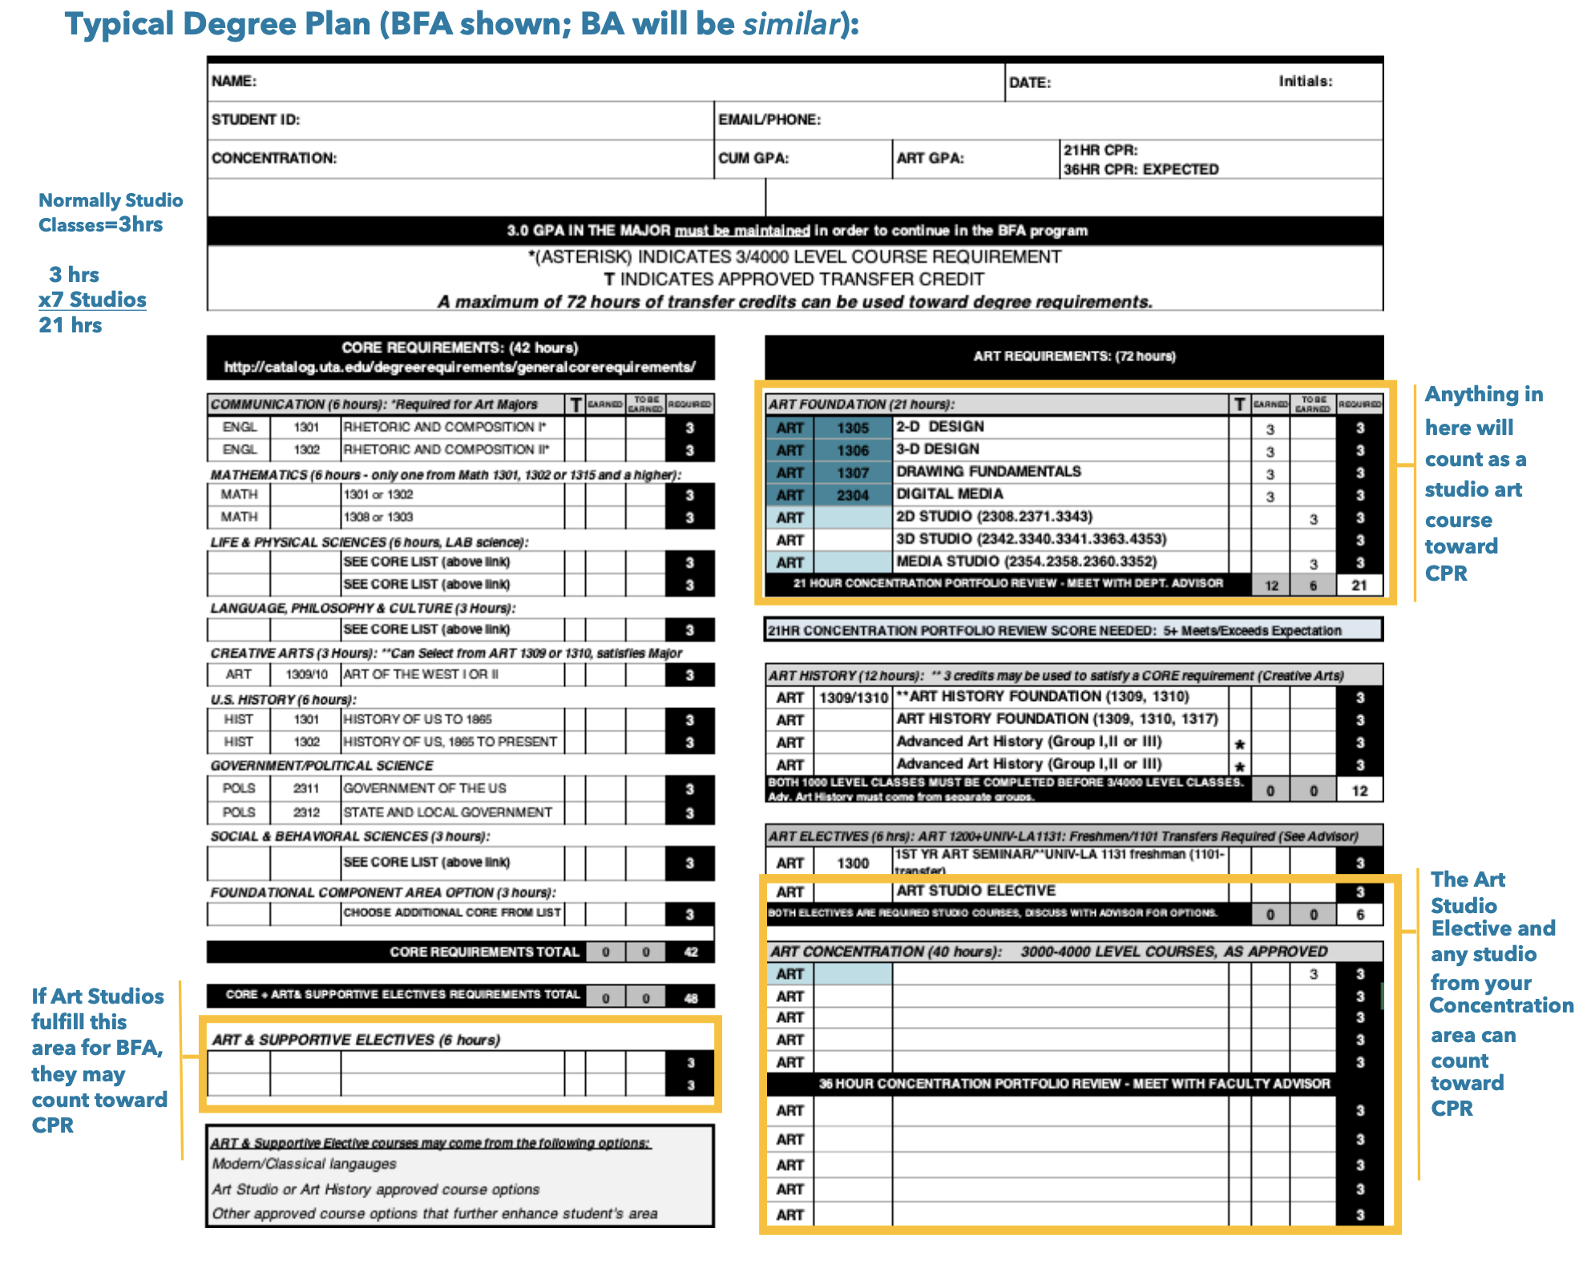
How to count your studio hours/classes
Full document on Art Advising Canvas page

Slide 5
How to go through review if you qualify
What’s the process?
Application: Entry Level Review Application & Submission
  Emailed to the Art major listserv
  Submit to your Area Coordinator (AC) by the deadline
  Some areas may have different deadlines than what’s listed on the Advising Calendar or within the email
  Always contact your AC for details!
After Applying: Your AC should provide more details via email; follow their guidelines

Slide 6
How to go through review (continued)
What’s the rest of the process?
Submit Artwork by deadline: Submit your required artwork/projects per your area’s requirements by their deadline
Faculty Review: The AC and other faculty within your area will review your work
Results: Your AC should reach out to you regarding your results & feedback

Slide 7
IMPORTANT!
Each concentration area is different. For the most accurate information, contact your Area Coordinator.

Slide 8
What’s next?
If I pass…
Passing Entry Level Review
  Art advisors update your MyMav to officially say BA or BFA
  Complete ADVISATHON for your earlier advising access/process
  Prepare for Advanced Level Review if your area requires it
Passing Advanced Level Review
  Continue with your BFA path and advising

Slide 9
What’s next if I…
…fail?
Failed 1st Attempt, Entry Level Review
  You’ll be given a 2nd chance the following semester
  Complete ADVISATHON (be sure you’re not on probation)
  Improve your work per feedback
Failed 2nd Attempt, Entry Level Review
  BA option if you qualify or you must change out of Art
Failed Advanced Level Review
  Pending AC feedback, may have 2nd attempt or may be required to move to BA if you qualify

Slide 10
Who do I contact?
Area Coordinators
Art Education: Lucy Bartholomee
Cinematic Arts: Daniel Garcia &
Patty Newton
Clay: Nick Wood
Design: design@uta.edu
Drawing: Carlos Donjuan
Glass: Justin Ginsberg
Interactive Media: Josh Wilson
Painting: Benjamin Terry
Photography: Bryan Florentin
Printmaking: Carrie Iverson
Sculpture: Fernando Johnson

Slide 11
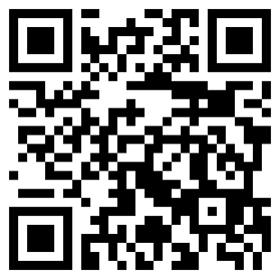
Art Advising Canvas Page!
https://uta.instructure.com/enroll/NGKG4T
This page is designed to be a one-stop shop for all of your art department needs!
To join this Canvas page, go to the link above or scan the QR and click “enroll in course.”
Information will be periodically updated as needed.

