Slide 1
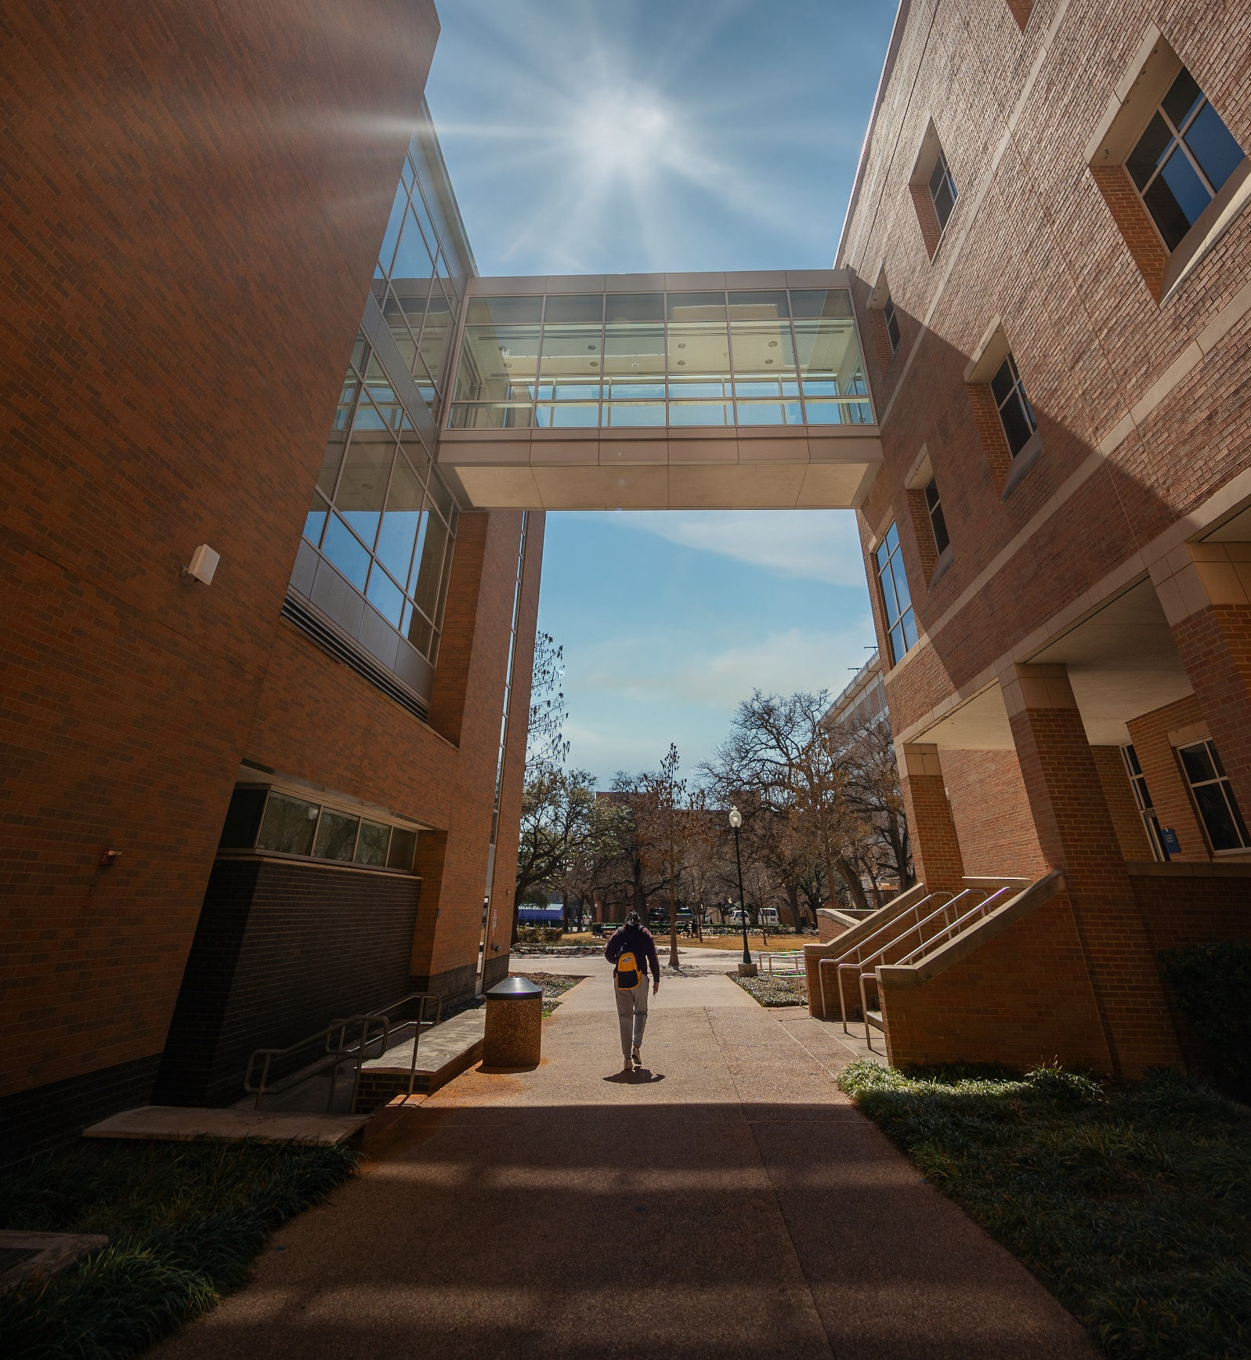
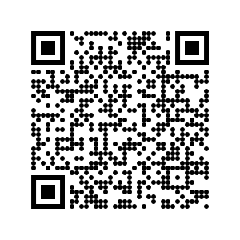
SPRING 2024 SOCIOLOGY COURSE CATALOG

Slide 2
SPRING 2024 SOCIOLOGY COURSES
SOCI 1200 SOCIOLOGY FOR PERSONAL & PROFESSIONAL SUCCESS M/W 8:00-8:50 Ms. Lauren Vanpool A first-year experience course for new students and new transfer students interested in a career in the social sciences. Provides the necessary foundation for success in a college environment while balancing personal and/or work obligations. Orients students to life on campus, demonstrates how to leverage campus resources to achieve career and academic goals, and emphasizes engagement outside the classroom through collaborative and co-curricular opportunities. Fulfills the University requirement for either UNIV 1101 or UNIV 1131.
SOCI 1310 INTRO TO POP CULTURE M/W/F 10:00-10:50 Dr. David Arditi Online Ms. Faye Hanson-Evans This course introduces students to the role of popular culture in American society. It examines culture as a process through which people make symbolic meaning out of the world. The course explores the creation, production, dissemination, reception, and consumption of popular culture. SOCI 1311 INTRO TO SOCIOLOGY M/W/F 9:00-9:50 Dr. Krystal Beamon M/W/F 11:00-11:50 Dr. Krystal Beamon ONLINE Dr. Lilian Chavez ONLINE (AO) Dr. Dorothy Kalanzi A scientific approach to the analysis and explanation of culture, personality, and social organization. The social processes and mechanisms of interaction involved in the natural process of cultural development, dissemination, assimilation, and the institutions of the group. This course satisfies the University of Texas at Arlington core curriculum requirement in Social and Behavioral Sciences.
SOCI 2312 SOCIAL PROBLEMS T/TH 11:00-12:20 Dr. Lilian Chavez A survey of contemporary social problems in the United States. Emphasis is on applying different theoretical perspectives and systematic procedures to understand social problems as public issues rather than personal problems. This course satisfies the University of Texas at Arlington core curriculum requirement in Social and Behavioral Sciences.

Slide 3
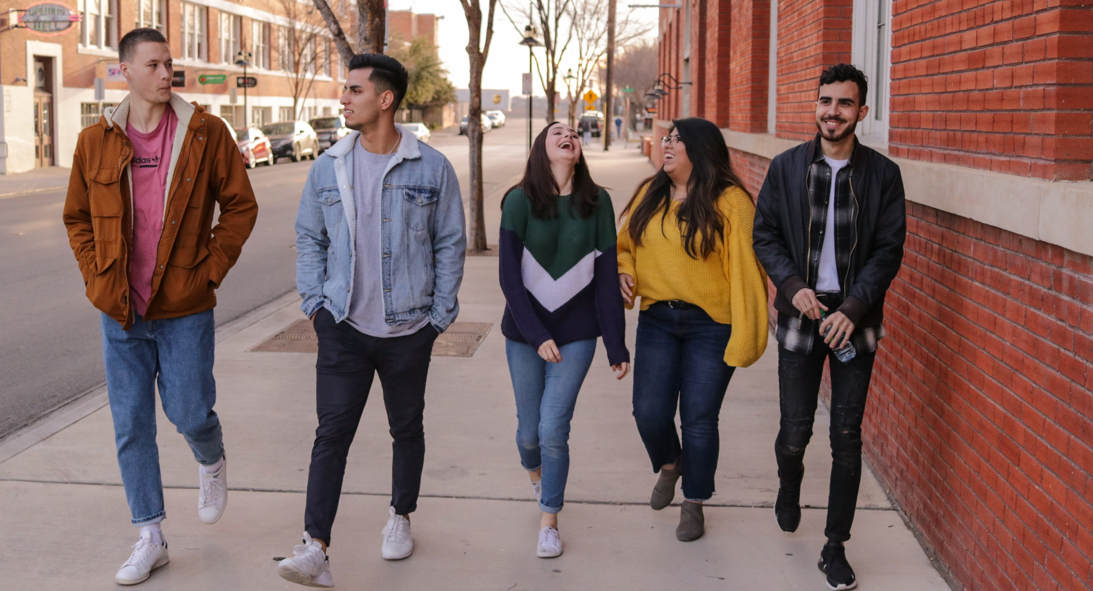
SOCI 3313 CRIMINOLOGY ONLINE Dr. Sara Skiles-duToit Crime-related social issues. Defining and measuring crime, surveying major theoretical explanations of criminal behavior, and society's formal responses to crime and criminals.
SOCI 3324 SOCIAL MOVEMENTS M/W/F 11:00-11:50 Dr. Kelly Bergstrand Focuses on twentieth and twenty-first century social movements, including the U.S. civil rights movement, the student and anti-war movements of the 1960s, the women's movement, the environmental movement, and anti-globalization movements. Status politics movements, such as pro-choice/pro-life and gay rights movements, are also explored. Compares these movements with their counterparts in other countries and identifies the reasons for their successes and failures. SOCI 3328 MARITAL & SEXUAL LIFESTYLES ONLINE Dr. Sara Skiles-duToit Contemporary American lifestyles selected from: singles, traditional marriage, homosexuals, single-parent families, open marriage, non-marital sexuality, cohabitation, dual-career marriage, childless couples, egalitarian marriage, families in later life.
SOCI 3331 SOCIOLOGY OF FAMILY M/W/F 1:00-1:50 Dr. Beth Anne Shelton The family's role in American society and in other cultures past, present, and future. Family research methods, comparative family systems, child development/parenting, culture and personality, minority families, social class variation in families, work and family.
SOCI 3334 SOCIOLOGY OF GENDER ONLINE Ms. Faye Hanson-Evans Examination of theoretical and empirical approaches to understanding the formation of gender. Assesses individual and structural dimensions of gender in various social institutions including work, education, and families.
SOCI 3336 SOCIAL INEQUALITY ONLINE Dr. Lilian Chavez Examines the processes, characteristics, and consequences of social inequality in society. Topics include the social class structure, status groups, and elite power structure as they influence people's life chances.

Slide 4
SOCI 3337 RACIAL & ETHNIC GROUPS IN THE UNITED STATES T/TH 9:30-10:50 Dr. Jason Shelton Compares the immigration, acculturation, and adjustment processes of various racial/ethnic groups in the U.S. Examines historical and contemporary discrimination in relation to the social conditions of racial/ethnic minority groups in the U. S. Topics include classical and contemporary theory; individualistic, cultural, and structural arguments about social arrangements; and conflict among majority and minority groups.
SOCI 3340 SOCIOLOGY OF EDUCATION T/TH 11:00-12:20 Dr. Alma Garza Social relations between the school and society, teachers and parents, teachers and school management, and other relevant relationships. Studying cooperation and conflict, values, complex organizational structure, and social change. Prerequisite: sophomore standing or permission of the instructor. SOCI 3341 SOCIOLOGY OF SPORT M/W/F 10:00-10:50 Dr. Krystal Beamon Sociological examination of the institution of sport in U.S. society. By examining selected topics such as sport and socialization, sport and politics, sport and education, the Olympics, race and sport, violence in sport, women in sport, and the business of sport, this course will address the social significance of sport and its function as a major social institution. SOCI 3347 ENVIRONMENT AND SOCIETY M/W/F 1:00-1:50 Dr. Kelly Bergstrand Explores the causes, consequences, and potential resolutions of environmental issues as they relate to human society. Topics include the social roots of environmental problems, inequalities in the distribution of environmental risks and harms, and new directions in sustainable development.
SOCI 3348 SOCIAL ASPECTS OF RISK T/TH 9:30-10:50 Dr. Robert Kunovich An examination of the social aspects of risk in everyday life. The course covers the relationship between risk and thrill-seeking behavior, risk assessment and the management of risk by technical experts, risk perceptions among the general public, and how technology and culture change the nature and meaning of risk over time.
SOCI 3351 WORK, OCCUPATIONS, AND CAREER DEVELOPMENT M/W/F 10:00-10:50 Dr. Beth Anne Shelton Combines applied information on career development with a sociological perspective on work and occupations. Career development topics may include academic majors and career options, networking, career mentorship and sponsorship, job searches, resume writing, and interviewing. Other topics may include the historical development of work, occupational structures (professional, managerial, service, and blue-collar occupations), inequalities, work satisfaction, work-life balance, and the future of work. SOCI 3352 SOCIAL STATISTICS T/TH 11:00-12:20 Dr. Robert Kunovich The social sciences and related applied fields today require some familiarity with statistical methods of data analysis. This course introduces a set of concepts that will help students understand numerical description, inference and explanation applied to human society and social behavior. Emphasis is on statistical reasoning and interpretation; what statistics to use for particular purposes and how to make sense of the results.
SOCI 3356 WOMEN, WORK, AND SOCIAL CHANGE M/W/F 11:00-11:50 Dr. Beth Anne Shelton Women's work experiences, how these experiences are changing, and relationship between paid employment and non-wage household labor. Paid and unpaid work experiences are empirically examined in terms of a variety of theoretical perspectives.

Slide 5
SOCI 3372 SOCIOLOGICAL THEORY T/TH 12:30-1:50 Dr. Alma Garza This course introduces students to major theories and figures who have provided sociology with interpretations of the social world. Students will consider how sociologists use theoretical concepts to understand social interactions, social problems, and social change. Students will apply sociological theories to social phenomena. Prerequisite: junior standing or permission of the instructor.
SOCI 4306 QUALITATIVE RESEARCH METHODS TH 2:00-4:50 Dr. Heather Jacobson Conceptual frameworks and techniques for planning, conducting, analyzing, reporting and evaluating qualitative research. Topics include interviewing, participant observation, coding, case studies and focus groups. Prerequisite: sophomore standing or permission of the instructor. SOCI 4320 MEDICAL SOCIOLOGY ONLINE Dr. Dorothy Kalanzi The relationships between different societies and social groups and their incidence of disease and mortality. Also examines culture-related causes of disease and treatment approaches, medicine as an occupation, healer-patient relationships, and the modern hospital as a bureaucratic organization.
SOCI 5305 RACIAL & ETHNIC GROUPS IN THE UNITED STATES T/TH 9:30-10:50 Dr. Jason Shelton This seminar course compares and contrasts the immigration, acculturation, and adjustment processes of various racial and ethnic groups in the United States. We will examine conventional and controversial arguments, as well as classical and contemporary theories concerning the dynamics of inter-group relations in America. Some of the more controversial topics in sociology-such as debates over assimilation, Americanization, and enduring conflicts between groups-are the foremost intellectual topics to be addressed. The reading list includes a diverse group of scholars who advance relevant research on race and ethnic relations.

Slide 6
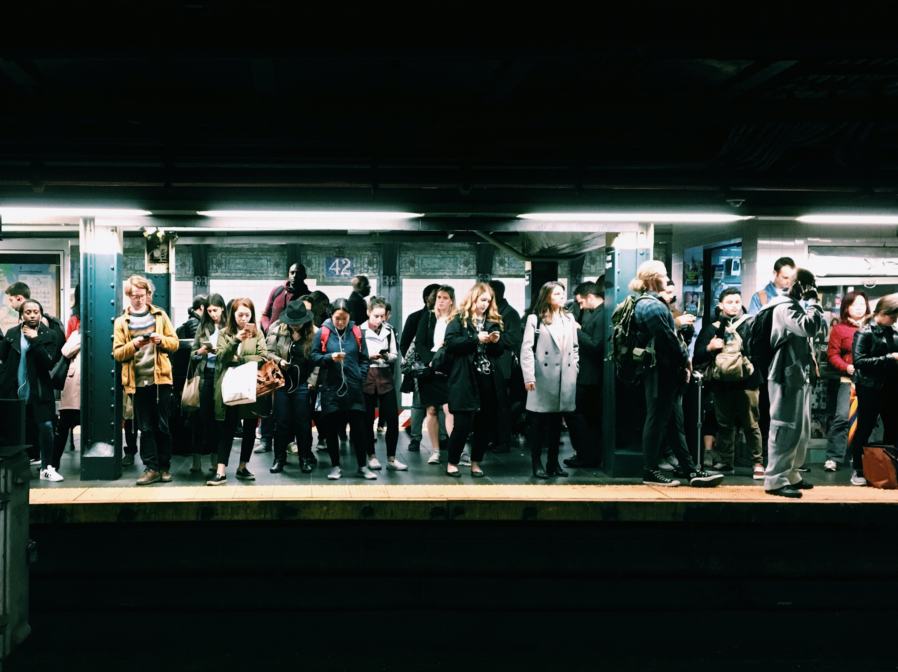
SOCI 5317 CULTURAL SOCIOLOGY T 2:00-4:50 Dr. David Arditi This seminar course examines the relationship between culture and society. Students will study contemporary debates around culture. Students will pay special attention to the use and experience of popular symbols for the ways that their use involves the creation of meanings.
SOCI 5324 QUALITATIVE RESEARCH METHODS TH 2-4:50 Dr. Heather Jacobson This seminar course introduces students to the qualitative tradition in sociology. We will study the assumptions underlying qualitative methods and important ethical and theoretical issues in field work. Students will become familiar with ethnographic research techniques (participant-observation and in-depth interviewing) and implement those methods in an individual small-scale research project.
MAJOR IN SOCIOLOGY Interested in majoring or minoring in one of our sociology degrees? Schedule an appointment with our undergraduate advisor: Mrs. Lauren Vanpool, M.A. lauren.vanpool@uta.edu
UH 434 (817) 272-3789 Click here to schedule an advising appointment!
MINOR IN SOCIOLOGY The Sociology minor requires 6 courses (18 hours) of Sociology courses. Courses fulfilling core requirements count toward the minor. MINOR IN POPULAR CULTURE The Popular Culture minor helps prepare students to work in the entertainment industry and/or to understand the role of popular culture in their everyday lives.
Find us on Facebook: facebook.com/UTASociology

