Slide 1
UTA Logo on blue background
Updated 05/17/22

Slide 2
Indirect Taxes
Helping Businesses Navigate the SALTy Seas
Brandon K. Hayes, CMI
Director of Indirect Taxes

Slide 3
Learning Objectives
Discuss and understand emerging nexus traps used by state enforcement agencies
Identify common tactics used by state auditors and discuss strategies on how to avoid them.
Identify and understand how to utilize common exemptions in uncommon situations to legally minimize sales and use tax liability.
Discuss various dispute resolution options and understand the advantages and disadvantages of each.

Slide 4
Nexus Traps
Sales and Use Tax Purposes

Slide 5
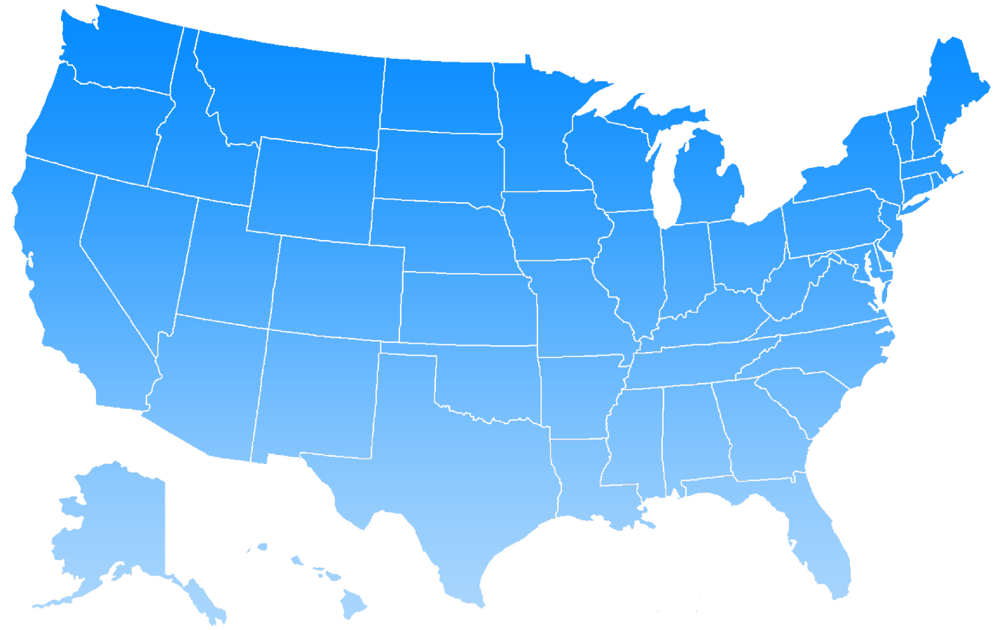
Nexus Trends
Sales and Use Tax
Quick Recap: What is “nexus” and how does it work for sales tax purposes?
Nexus: A minimum connection required between a state and a company which allows a state to assert jurisdiction for the purposes of complying with its laws.
Physical Nexus: Maintaining or occupying either permanently or temporarily, directly or indirectly or through a subsidiary, an office, DC, store room, or any other place of business.
Economic Nexus: Requires an out-of-state retailer to collect and remit sales tax once the retailer meets a specified number of transactions or gross receipt activity within the state.
“Small Seller” thresholds vary by state, but typically $100K in sales “and” 200 transactions.

Slide 6
Nexus Trends: Affiliate Nexus
It’s still a thing!
Affiliate Nexus: Nexus triggered via an affiliated business or individual in the state whereby sales are generated from this connection.
Common relationship occurs between “brick and mortar” and dot.com entities.
Affilliate nexus may be triggered by sharing web links, coupons, discount codes and other means of enticement.
Many states repealed their affiliate nexus laws after imposing economic nexus laws. However, several states kept their affiliate nexus rules in place or reinstated them.
Illinois initially repealed it, but later reinstated it in 2020
Other states that either kept or reinstated affiliate nexus laws include:
IA, KS, LA, ME, NJ, NY, NV, RI

Slide 7
Nexus Trends: Trailing Nexus
Also, still a thing!
“Trailing nexus” rules require previously registered taxpayers to continue collecting and remitting sales tax for a specified amount of time “after” the business ceases to do business in the state.
Not all states have trailing nexus rules.
Timetables vary for states with trailing nexus.
Typically range from remaining quarter to end of calendar year.
States with some type of trailing nexus rules include:
AZ, CO, CA, GA, HI, IL, MA and MI

Slide 8
Nexus Trends: Public Law 86-272
Public Law 86-272
No state, or political subdivisions thereof, shall have power to impose…a net income tax on the income derived within such State by any person from interstate commerce if the only business activities within such State by or on behalf of such person during such taxable year are either, or both, of the following:
(1) Solicitation of orders by such person, or his representative, in such State for sales of tangible personal property, which orders are sent outside the State for approval or rejection, and, if approved, are filled by shipment or delivery from a point outside the State, and…
(2) The solicitation of orders by such a person, or his representative, in such State in the name of or for the benefit of a prospective customer of such a person, if orders by such customer to such person to enable such customer to fill orders resulting from such solicitation are orders described in paragraph (1).

Slide 9
Nexus Trends: Public Law 86-272, cont.
While “protected” activities may immunize an entity from net income taxation, the activities may still create nexus for the imposition of other state taxes such as sales tax.
It is highly possible for an entity to be immune from a state “income” taxation but be subject to the state’s sales and use tax compliance.
Ex. Transporting goods using a company vehicle may not negate an entity’s PL 86-272 protections for state income tax purposes. However, using a company vehicle to deliver goods into a state from outside the state WILL establish nexus for sales and use tax purposes!

Slide 10
Common Audit Tactics
How to Avoid Them

Slide 11
Common Audit Tactics
Auditors’ Low Hanging Fruit
Exemption and Resale Certificates
Missing or Incomplete
Improper Use
Using an incorrect form to assert a specific exemption
Using forms from the wrong state
Issuing or accepting forms that don’t make sense
States typically allow the taxpayer additional time to revise or obtain certificates.
Timing varies by state – typically 30-60 days
Texas has expanded retrieval to 90 days

Slide 12
Common Audit Tactics, cont.
Real Property Services
Tex. Admin Code § 3.356 – Real Property Services
Grounds keeping and lawn maintenance
(e) Landscaping, lawn, and yard maintenance provided by persons under 18 years old or by persons 65 years old or older. Charges for the performance of landscaping, lawn, and yard maintenance services (subsection (a)(4) and (5) of this section) are exempt if performed by:
(1) a self-employed person under 18 years of age whose total receipts from providing landscaping, lawn, or yard maintenance are $1,000 or less during either the preceding calendar quarter or the same calendar quarter of the preceding year;

Slide 13
Common Audit Tactics, cont.
Data Processing Services
Tex. Admin. Code § 3.330(a) – Data Processing Services
Data processing services - the processing of information for the purpose of compiling and producing records of transactions, maintaining information, and entering and retrieving information. It specifically includes word processing, payroll and business accounting, and computerized data and information storage or manipulation. The charge for data processing services is taxable regardless of the ownership of the computer. Examples of data processing services include entering inventory control data for a company, maintaining records of employee work time, filing payroll tax returns, preparing W-2 forms, and computing and preparing payroll checks…

Slide 14
Common Audit Tactics, cont.
Managed Service Agreements
Management services are not an enumerated taxable service; however, other services incorporated into or wrapped within a MSA may be a taxable enumerated service.
Lack of bifurcation in pricing may render the entire contract to be taxed.
States may allow “de minimis” threshold for comingled services.
Auditors routinely challenge the value of the “taxable” services being performed in order to exceed state’s minimum threshold

Slide 15
Common Audit Tactics, cont.
Managed Service Agreements
Human Resources and Payroll Services
Prepare offer letters with Client approval. Facilitate background checks for candidates with third-party providers, process payroll, as well as monitor remittance of taxes. Prepare cash requirements for payroll each pay period. Create payroll journal entries for general ledger postings. Update demographic information as required.
Information Systems Services
Oversee management of document repositories. Evaluate and make recommendations concerning technology acquisitions for Client. Manage email and messaging systems. Support and monitor productivity applications. Evaluate and make recommendations concerning cybersecurity and fraud protection as well as undertake projects as requested by Client.

Slide 16
Applying Common Exemptions
(In Uncommon Situations)

Slide 17
Sale for Resale
Sale for Resale: The sale of a taxable item to a purchaser who acquires the taxable item for the purpose of reselling, renting or leasing the taxable in the US or Mexico in the normal course of business in the form in which it was acquired or as an attachment or integral part of another taxable item.
Sale for Resale exemption may ONLY be used by permitted taxpayers and may be used when purchasing either tangible personal property (“TPP”) or a taxable service.
A properly completed resale certificate must be provided to the vendor at the time of purchase.
Item or taxable service must be transferred to or for the benefit of the ultimate consumer.

Slide 18
Sale for Resale, cont.
Creative Application
Resale Transaction Flow:
Requires creation of separate legal entities (Equipment Entity/Operator Entity).
Equipment LLC MUST obtain sales tax permit BEFORE purchasing equipment.
Equipment LLC leases equipment to Operator Entity.
Operator Entity pays lease payment with tax to Equipment LLC.

Slide 19
Sale for Resale, cont.
Initial Purchase: $250,000
Sales Tax Due: $20,625
60 Lease Payments: $120,000
Sales Tax: $9,900
Potential Tax Savings: $10,750
Resale Transaction Flow
Sales Tax Permit
Equipment LLC
Operating Lease Agreement
Operator
LLC
Lease Payment $2K a month with sales tax

Slide 20
Scheduled and Periodic Maintenance
Tex. Admin. Code § 3.357 – Real Property Scheduled and Periodic Maintenance Defined
Maintenance: For operational and functional improvements to realty, maintenance means scheduled, periodic work that is necessary to sustain or support safe, efficient, continuous operations, or to prevent the decline, failure, lapse, or deterioration of the improvement.
Scheduled: Anticipated and designated to occur within a given time period or production level.
Periodic: Ongoing or continual or at least occurring in intervals of time or production that are reasonably predictable.
Exclusions: Cannot be used to exempt services specifically taxed under Tax Admin Code § 3.356
Lawn Maintenance, Landscaping, Pest control, Waste Removal

Slide 21
Scheduled and Periodic Maintenance, cont.
How does the exemption work?
Repairs to real property are deemed taxable in Texas. A repair is to mend or bring back real property that was broken, damaged or defective to its original working order.
Work done to “prevent” real property from becoming defective or in decline is excluded from the definition of repair.
Examples of exempt scheduled and periodic maintenance:
Scheduled HVAC maintenance, lighting services, painting and/or antimicrobial recoating, parking lot restriping

Slide 22
Dispute Resolution Options:
Advantages and Disadvantages

Slide 23
Dispute Resolution Options
Reconciliation Conference
Informal meeting with audit supervisor and/or office manager.
Advantages: Least expensive and timing consuming option.
Disadvantages: Supervisors and managers rarely contradict auditor findings.
When to use: Best for resolving issues related to anemic or missing documentation. Primarily when dealing with missing invoices and/or supporting documentation.
Audit supervisors and audit office managers typically exercise more discretion than field auditors in order to prevent disagreed audits from escalating to hearings.

Slide 24
Dispute Resolution Options, cont.
Independent Audit Review Conference (aka “IARC”)
Conference between Comptroller-appointed Independent Audit Reviewer (“Reviewer”), audit office personnel and taxpayer. The Reviewer is a seasoned Comptroller employee with deep knowledge of tax policies, procedures and issues; however, they are not part of the audit division.
Advantages: Inexpensive compared to more formal resolution options. Offers more discretion for resolution of certain types of issues including taxability issues, sampling issues, accounting disputes and potential waiver penalty and interest.
Disadvantages: Reviewers are former auditors. Somewhat duplicative as Reviewer may request additional information and/or rework the audit.
When to use: After reconciliation conference and before hearings discussions. Effective when requesting taxability penalty and interest waiver.

Slide 25
Dispute Resolution Options, cont.
Offer in Compromise
“Settlement offer” discussed and negotiated with a Comptroller’s Settlement Officer. Taxpayer may not immediately request a settlement offer. Typically, must follow the “exhaustion doctrine” prior to settlement discussions.
Advantages: May allow for acceptable resolution without the time and expense of an administrative hearing.
Disadvantages: Typically, only settles prior periods. Decisions or compromises may not be used for prospective determinations.
When to use: Must file “Petition for Redetermination” as though you are going to hearings first. May request Offer in Compromise with CSO after your case has been referred to hearings.

Slide 26
Questions?

