Slide 1
Top Ten Things You Need to Know:
Academic Year 2021-2022
New Faculty Orientation

Slide 2
#1: Progress Reports, Grades in Canvas
Required for long semesters
(fall / spring)
Week Three and Four
First-year students, athletes, undeclared
Week Eight
First-year
Undeclared
Athletes
Academically at-risk
Be prepared to submit grades on time
Design early progress assignments-syllabus quiz?
Notes:
Canvas helps our students stay abreast of their grades and thus requires for instructors teaching undergrads to think through assignments that require a 4 week grade– a short syllabus quiz or assignment that provides an indicator of their engagement. Important to submit grades on time as repercussions for our students can be serious- dropping due to prerequisite, impact on financial aid.
F grades require a date of last attendance in Canvas:
Option 1 - In attendance/performed poorly Option 2 - Stopped attending as of ___(“date last attended” will be required) Option 3 - Never attended or participated

Slide 3
#2: Students with Disabilities
Academic Accommodations
Legislatively mandated
Students seeking accommodations must register
No “informal accommodation”
Student Access & Resource Center
SARCENTER@UTA.EDU
Textbooks must have accessibility option (e-Book, or in Bookstore library for accessible books)
Videos can be transcribed with Canvas Studio or Teams to provide close captioning.

Slide 4
#3: Student Feedback Surveys
Faculty Guidelines
Discuss the importance
of survey with students
Class, e-mail, Canvas
Provide time during class to complete the survey
Administered online last two week of classes (before final exam period)
Results in a dashboard with real time data
Upload reports every semester into DM faculty profile
www.utarlington.smartevals.edu
or
Institutional Effectiveness & Reporting
https://www.uta.edu/ier/
Notes:
Important to check that the end date of your course is correct in MyMav
If more than one instructor, make sure administrative assistant informs Arnita Williams in IER

Slide 5
#4: Syllabus Requirements
HB 2504 Syllabi & Vita Posting
Posted in Canvas by first class meeting
Syllabi will migrate to Digital Measures
Must use Canvas syllabi template (for accessibility)
Template is in Canvas course shell or here https://resources.uta.edu/provost/
Required syllabus content
Major assignments
Materials
“Three click” rule

Slide 6
#5 Peer Observation of Teaching
UT System Policy: Rule 31102
Evidence of peer observation of teaching required for promotion or tenure: two before tenure (pre- and post-third year review)
Supervisor cannot be peer observer
List of Certified Peer Observers
https://www.uta.edu/administration/provost/units/faculty-affairs/professional-advancement/peer-observation/certified-peer-observers-by-college
Forms:
https://www.uta.edu/administration/provost/units/faculty-affairs/professional-advancement/peer-observation
See Your New Faculty Canvas Classroom for more information
Notes:
Toni

Slide 7
#6 Campus Carry
HB 1927 Constitutional Carry has no effect on institutions of higher education and our current Campus Carry regulations remain.
Permit holders may carry a concealed handgun in public university buildings that are not exclusionary areas under UTA policy.
Two separate laws:
Open Carry: handgun can be in a holster and is visible. Not allowed on campus.
Concealed Carry: the handgun may not be visible. Only allowed for license holders (21+ years old).
If you see any type of firearm on campus, call campus police: 817-272-3003 www.uta.edu/police

Slide 8
#7 Concerns about Students?
A Community that Cares (uta.edu/communitythatcares)
Behavior Intervention Team (BIT) bit@uta.edu
Campus professionals ready to assist students experiencing significant behavioral disturbances
Academic Support
2nd floor of library: Academic Plaza
IDEAS Center & UTSI (University Tutoring and Supplemental Instruction), Writing Center (4th floor)

Slide 9
#8: Title IX
Title IX of the Education Amendment of 1972
Federal law
Prohibits discrimination based on gender at educational institution that receive federal financial assistance
Prohibits sexual assault and sexual violence
All faculty members are “responsible employees” (HOP 5-513)
http://www.uta.edu/titleix
Notes:
A Responsible Employee is a university employee who has the duty to report incidents of sexual misconduct to the Title IX Coordinator or other appropriate designee, or an employee whom an individual could reasonably believe has this duty. Responsible employees include all administrators, faculty, supervisory staff, resident life directors and advisors, and graduate teaching assistants

Slide 10
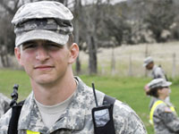
#9 Our Students
UTA Global enrollment :
48,635 students including
34,820 Undergrads
13,815 Graduate
54% of students are enrolled in at least one online course
Generally, 63% of students are enrolled in at least one online course
UTA’s military-connected population is just over 4,936 (veterans and family)
65% of UTA’s more than 220,000 alumni live in North Texas
One of six to be named “Next-Generation University”
Notes:
Global enrollment includes In-state; Out-of-state, all AP/Non-AP students for Fall 2018.

Slide 11
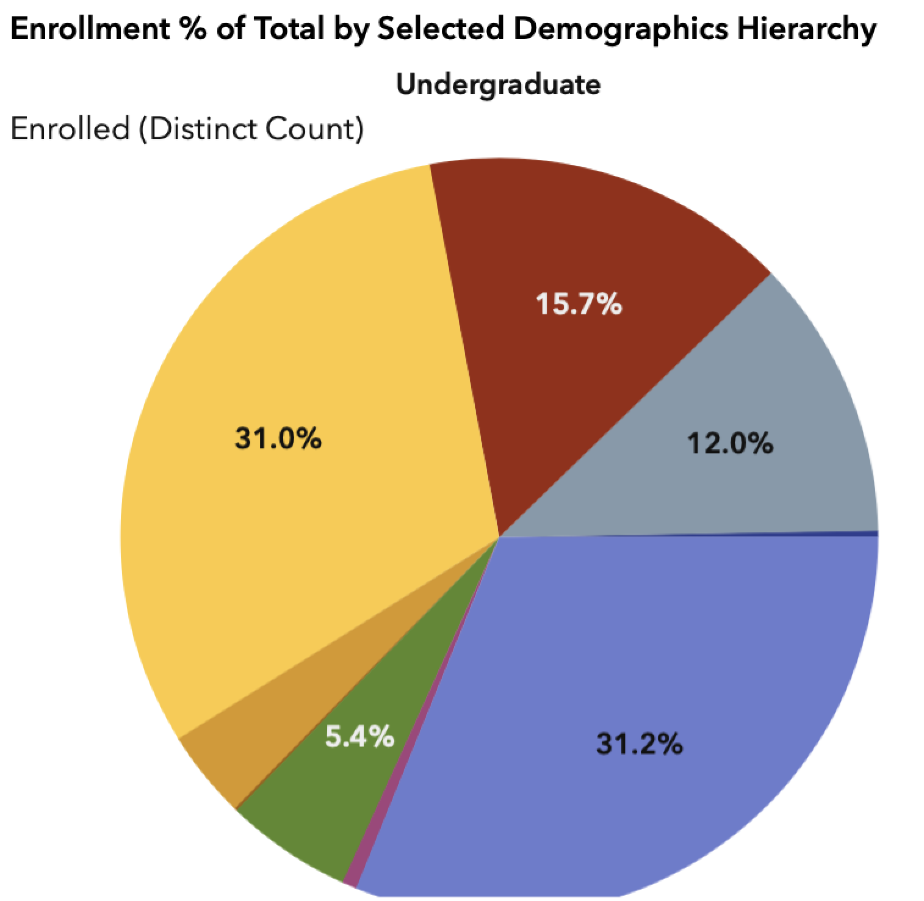
#10: The serve the student population of the 21st century urban research university:
Fifth-Most Diverse University in the U.S.
Hispanic-Serving Institution (HSI) and R1
International students representing over 100 countries
57% of students are 25+ years old (F20)
Notes:
The HSI designation is important as it opens the door to funding set-asides by federal agencies including USDA, Department of

Slide 12
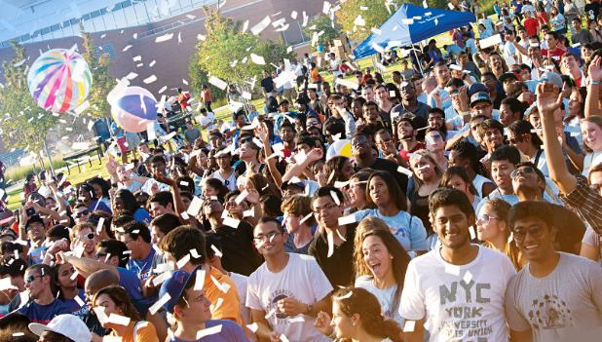
We are UTA!
Notes:
Global headcount meaning the actual headcount of all students enrolled for credit at UT Arlington.

Slide 13
Helpful Websites
Office of the Provost
http://www.uta.edu/provost
Division of Faculty Affairs
http://www.uta.edu/facultyaffairs
Blackboard
https://elearn.uta.edu
Handbook of Operating Procedures (HOP)
https://www.uta.edu/hop
Notes:
Syllabus template; FAN; REP and FDL/third year research reapportionment;
Resource fair- order regalia; invisible parking permit; OIT for net ID issues

Slide 14
#11 …..
Notes:
Syllabus template; FAN; REP and FDL/third year research reapportionment;
Resource fair- order regalia; invisible parking permit; OIT for net ID issues

